Slide 1



THE #1 RISK RETIREES FACE AND HOW YOU CAN HELP FINANCIAL ADVISORS SOLVE IT
For professional use only. Not intended for consumer use.
v
#4408690300
1

Slide 2


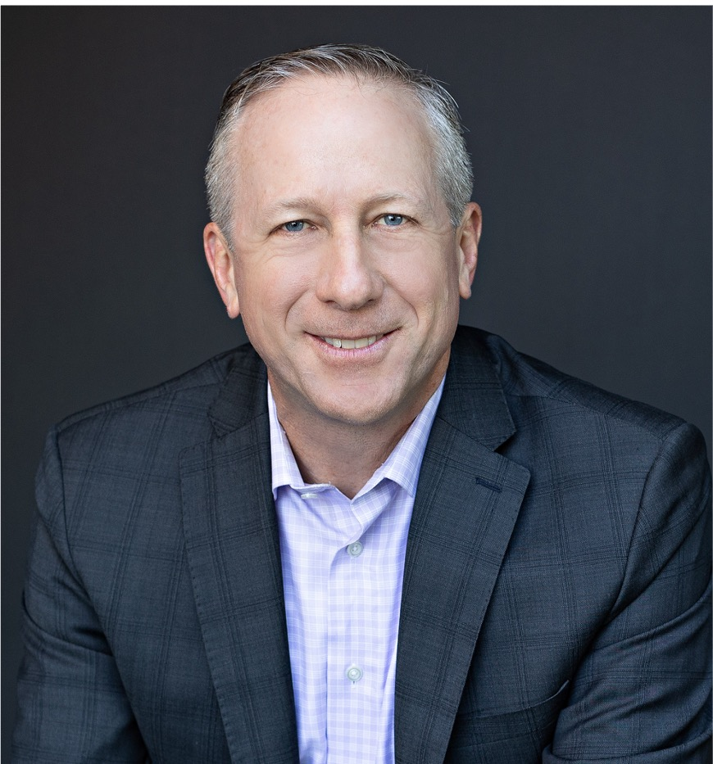
YOUR SPEAKERS
SVP of Wholesale
linkedin.com/in/mark-oneil
Mark O’Neil has over 20 years of experience in reverse mortgages, with a background as a real estate attorney, loan officer, and top-producing wholesale AE. He currently serves as SVP of Wholesale at Mutual of Omaha Reverse Mortgage, leading the channel’s national growth.
Speaker | Author | Financial Strategist
https://www.linkedin.com/in/ryanponsford/
Ryan Ponsford, MBA has over 25 years of experience in wealth management, real estate, lending, and philanthropy. As leader of Equity Wealth Strategies, he works to reframe reverse mortgages as a smart, responsible tool in retirement planning. Ryan holds an Executive MBA from Johns Hopkins and has spoken at events across the U.S., Canada, and Europe.
Notes:
It’s my pleasure to welcome our special guest, Ryan Ponsford. Ryan is one of the industry’s most respected advisor voices and a longtime ally to the reverse mortgage community. With more than 25 years of experience in wealth management, real estate, and lending, Ryan works closely with advisors and lenders to position reverse mortgages as a responsible, strategic retirement planning tool. Ryan, thank you so much for being here today! It’s great to see you, my friend!
And of course, our very own Mark O’Neil and SVP of Wholesale at Mutual of Omaha Reverse Mortgage. Mark brings over 20 years of reverse mortgage experience, with a background as a real estate attorney, loan officer, and top-producing wholesale AE, and currently leads our wholesale channel’s national growth.
With that, please join me in welcoming both Ryan and Mark. Mark…before we dive in, I have a short clip to play for everyone. I’m sure most on this call are familiar with Seth Rogan, Comedic Actor, Director, Producer.

Slide 3


Notes:
Seth Rogen and his wife, Lauren Miller Rogen, have become prominent advocates for Alzheimer’s care following her mother's early-onset diagnosis. They documented their experience in the film Taking Care, highlighting the challenges, the need for support, and their work with the Hilarity for Charity non-profit to support caregivers. Here’s a clip that the AARP shared from that interview.
Source: https://people.com/seth-rogen-and-wife-lauren-miller-alzheimers-taking-care-new-documentary-exclusive-8770127#:~:text=Seth%20Rogen%20and%20Wife%20Lauren%20Miller%20Recall,the%20disease%20and%20funds%20for%20those%20impacted
Video source: https://www.youtube.com/shorts/9XJ0g_TDjmg

Slide 4
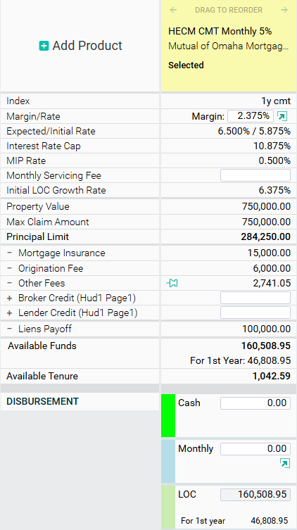
Age 68, Home Value: $750,000
HECM Refinance paying off an existing $100,000 lien
Starting Line of Credit = $160,508
Next two slides illustrate LOC growth
No monthly mortgage payments*
Monthly interest only payments
*Borrower must occupy home as primary residence and remain current on property taxes, homeowner's insurance, the costs of home maintenance, and any HOA fees.

Slide 5
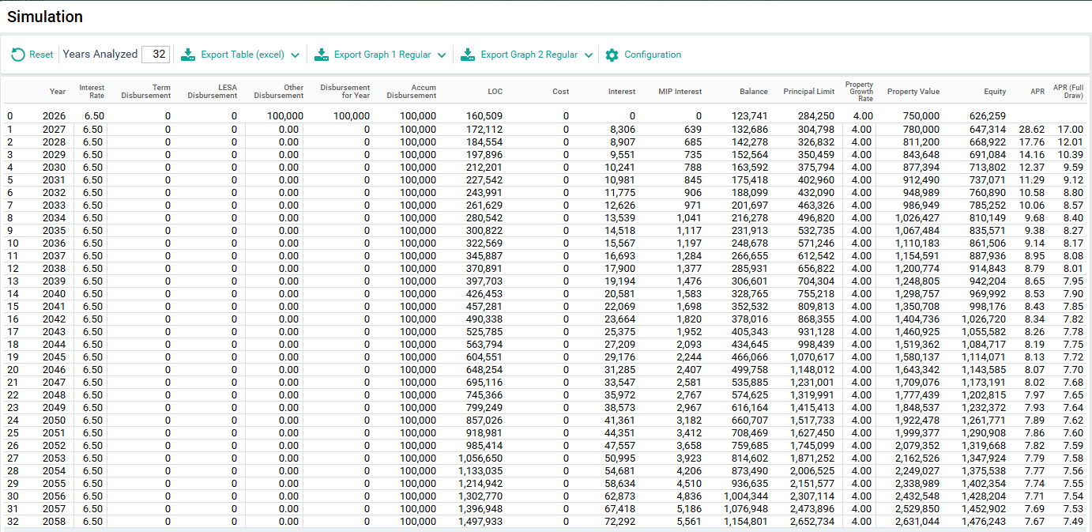
WITHOUT PAYMENTS
LOC Growth
$160k
$323k
Available Loan Proceeds $285k
$571k

Slide 6
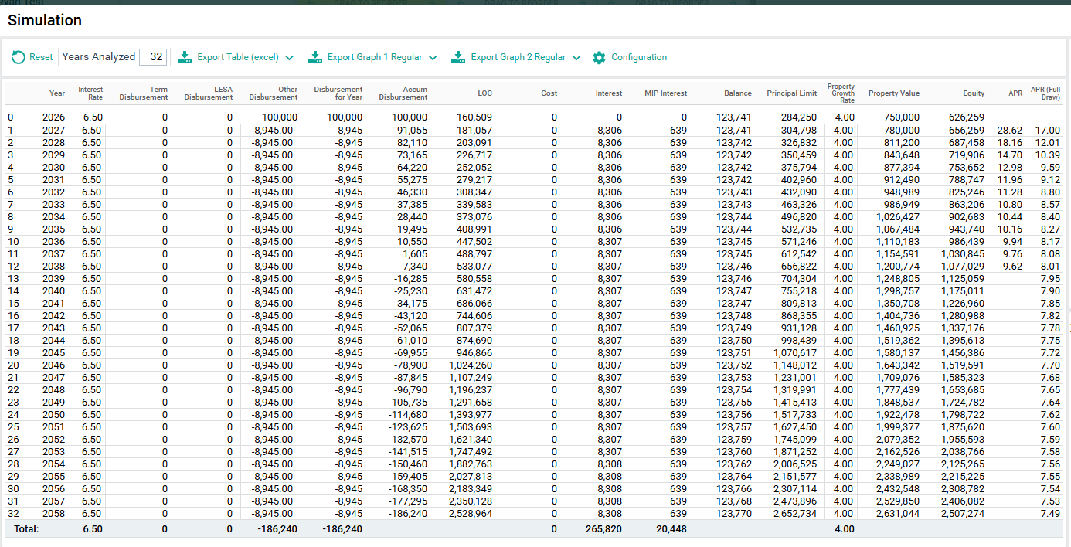
WITH PAYMENTS
LOC Growth
$160k
$447k
Available Loan Proceeds $285k
$571k

Slide 7


www.EquityWealthAcademy.com
Coupon Code: MUTUALOFOMAHA
Connect with Ryan
LinkedIn.com/in/RyanPonsford
Rponsford@EquityWealthStrategies.com

Slide 8

These materials are designed to provide the reader with a general overview and understanding of the topic(s) presented and are not intended as a substitute for consultation with qualified legal counsel regarding the manner, in which the laws, regulations, and guidelines covered may apply to a particular fact pattern or business model. No part of this presentation may be reproduced, forwarded, copied, or redistributed in any form or by any means without the prior written consent of Mutual of Omaha Mortgage (“MOOM”). This presentation could include technical inaccuracies or typographical errors. MOOM does not guarantee the accuracy of the information provided and disclaims any and all express or implied warranties, including, but not limited to, any warranties of merchantability or fitness for a particular purpose or use. This presentation should not be construed as legal advice or relied on as a sole resource for any part of the Lifestyle Home Loan. Unauthorized reproduction, forwarding, distribution or display of this copyrighted work is subject to criminal and civil penalties under federal law. These materials are not from and were not approved by HUD or FHA.
8

Slide 9

Borrower must occupy home as primary residence and remain current on property taxes, homeowner’s insurance, the costs of home maintenance, and any HOA fees.
Mutual of Omaha Mortgage, Inc. dba Mutual of Omaha Reverse Mortgage, NMLS ID 1025894. 3131 Camino Del Rio N 1100, San Diego, CA 92108. Alabama Consumer Credit License 22123; Alaska Broker/Lender License AK1025894. Arizona Mortgage Banker License 0926603; Arkansas Combination Mortgage Banker/Broker/Servicer License 109250; Licensed by the Department of Financial Protection & Innovation under the California Residential Mortgage Lending Act, License 4131356; Colorado Mortgage Registration 1025894; Connecticut Mortgage Lender License ML-1025894; Delaware Lender License 028515; District of Columbia Mortgage Dual Authority License MLB1025894; Florida Mortgage Lender Servicer License MLD1827; Georgia Mortgage Lender License/Registration 46648; Hawaii Mortgage Loan Originator Company License HI-1025894; Idaho Mortgage Broker/Lender License MBL-2081025894; Illinois Residential Mortgage Licensee MB.6761115; Indiana-DFI Mortgage Lending License 43321; Iowa Mortgage Banker License 2019-0119; Kansas Mortgage Company License MC.0025612; Kentucky Mortgage Company License MC707287; Louisiana Residential Mortgage Lending License 1025894; Maine Supervised Lender License 1025894; Maryland Mortgage Lender License 21678; Massachusetts Mortgage Broker and Lender License MC1025894; Michigan 1st Mortgage Broker/Lender/Servicer Registrant FR0022702; Minnesota Residential Mortgage Originator Exemption MN-OX-1025894; Mississippi Mortgage Lender 1025894; Missouri Mortgage Company License 21-2472; Montana Mortgage Broker and Lender License 1025894; Nebraska Mortgage Banker License 1025894; Nevada Exempt Company Registration 4830. Licensed by the New Hampshire Banking Department, Mortgage Banker License 19926-MB; Licensed by the New Jersey Banking and Insurance Department. New Jersey Residential Mortgage Lender License 1025894; New Mexico Mortgage Loan Company License 1025894; North Carolina Mortgage Lender License L-186305; North Dakota Money Broker License MB103387; Ohio Residential Mortgage Lending Act Certificate of Registration RM.804535.000; Oklahoma Mortgage Lender License ML012498; Oregon Mortgage Lending License ML- 5208; Pennsylvania Mortgage Lender License 72932; Rhode Island Lender License 20163229LL. Rhode Island Loan Broker License 20163230LB; South Carolina BFI Mortgage Lender/Servicer License MLS-1025894; South Dakota Mortgage Lender License ML.05253; Tennessee Mortgage License 190182; Texas Mortgage Banker Registration 1025894; Utah Mortgage Entity License 8928021; Vermont Lender License 6891; Virginia Mortgage Broker and Lender License, NMLS ID #1025894 (www.nmlsconsumeraccess.org); Washington Consumer Loan Company License CL-1025894; Wisconsin Mortgage Banker License 1025894BA; Wyoming Mortgage Lender/Broker License 3488. (866) 200-3210. Subject to Credit Approval.
Charges such as an origination fee, mortgage insurance premiums, closing costs and/or servicing fees may be assessed and will be added to the loan balance. As long as you comply with the terms of the loan, you retain title until you sell or transfer the property, and, therefore, you are responsible for paying property taxes, insurance and maintenance. Failing to pay these amounts may cause the loan to become immediately due and/or subject the property to a tax lien, other encumbrance or foreclosure. The loan balance grows over time, and interest is added to that balance. Interest on a reverse mortgage is not deductible from your income tax until you repay all or part of the interest on the loan. Although the loan is non-recourse, at the maturity of the loan, the lender will have a claim against your property and you or your heirs may need to sell the property in order to repay the loan, or use other assets to repay the loan in order to retain the property.
These materials are not from HUD or FHA and the document was not approved by HUD, FHA or any Government Agency.
For licensing information, go to: www.nmlsconsumeraccess.org
9

Slide 10


Mutual of Omaha Mortgage, Inc. dba Mutual of Omaha Reverse Mortgage, NMLS ID 1025894. 3131 Camino Del Rio N 1100, San Diego, CA 92108. Subject to Credit Approval.
10

