Slide 1
HEADER
SUBJECT/SUBHEAD:

Slide 2
These materials are designed to provide the reader with a general overview and understanding of the topic(s) presented and are not intended as a substitute for consultation with qualified legal counsel regarding the manner, in which the laws, regulations, and guidelines covered may apply to a particular fact pattern or business model. No part of this presentation may be reproduced, forwarded, copied, or redistributed in any form or by any means without the prior written consent of Mutual of Omaha Mortgage, Inc., dba Mutual of Omaha Reverse Mortgage. This presentation could include technical inaccuracies or typographical errors. Mutual of Omaha Mortgage does not guarantee the accuracy of the information provided and disclaims any and all express or implied warranties, including, but not limited to, any warranties of merchantability or fitness for a particular purpose or use. This presentation should not be construed as legal advice or relied on as a sole resource for any part of the Home Equity Conversion Mortgage program. Unauthorized reproduction, forwarding, distribution or display of this copyrighted work is subject to criminal and civil penalties under federal law. These materials are not from and were not approved by HUD or FHA.

Slide 3

MY STORY
NAME
Company name
Title
Phone:
Email:
Website:
Bio Body Copy Section

Slide 4

WHY WE PARTNER WITH MUTUAL OF OMAHA MORTGAGE
Mutual has been helping seniors protect
their financial future for 100+ years
Specialize in insurance, retirement, and
longevity planning
Known for stability, protection, and doing
things “the right way”

Slide 5

WHY RETIREMENT RISK IS INCREASING
Americans are living longer—and retiring with more uncertainty
Healthcare, long-term care, and spousal loss risk
Market volatility, inflation, and healthcare costs threaten long-term security
Traditional pensions are disappearing
Most retirement wealth is tied up in home equity

Slide 6

THE OVERLOOKED ASSET: HOME EQUITY
Often treated as a last resort
Typically, the largest asset
Can be strategically coordinated with retirement planning
• Generate Cash Flow
• Portfolio Protection
• Tax-efficient income

Slide 7

TYPES OF REVERSE MORTGAGES
Home Equity Conversion Mortgage (HECM)
SecureEquity® Jumbo Reverse Mortgage
HECM for Purchase

Slide 8
WHAT IS A HOME EQUITY CONVERSION MORTGAGE (HECM)?
• Also known as a Reverse Mortgage
• FHA-insured reverse mortgage designed for older homeowners
• At least one of the borrowers must be 62 years old or older
• No monthly mortgage payments required
  • Must continue to pay property taxes, insurance, HOAs
  and maintain the property
• Non-recourse loan—you never owe more than the home’s value at time of sale
• Borrower retains title and control of the home, just like with a
traditional mortgage

Slide 9

JUMBO REVERSE MORTGAGE
• For high-valued properties
• Tax-free lump sum up to $4,000,000
• 100% of funds available in year one – unlike FHA reverse mortgages
• SecureEquity®: Minimum age is 55
  • Minimum age for LA, WA is 60, 62 in NC, NH, and TX.
• No Mortgage Premium Insurance (MIP)
• No monthly mortgage payments required
  • Must continue to pay property taxes, insurance, HOA and maintain the property
• Non-recourse loan—you never owe more than the home’s value at time of sale
• Borrower retains title and control of the home, just like with a traditional mortgage

Slide 10
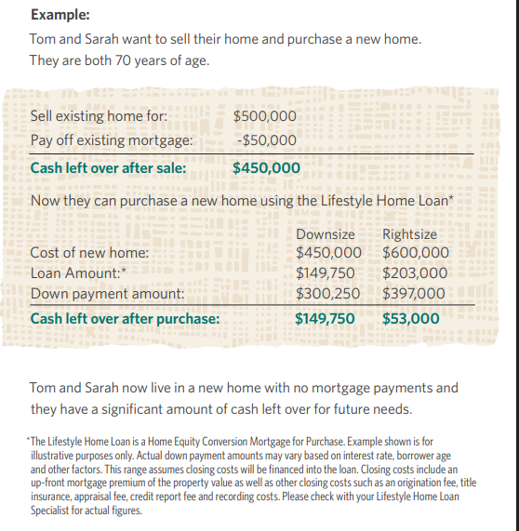
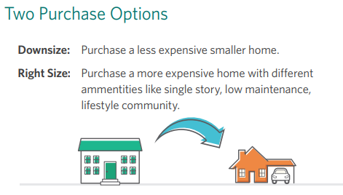
REVERSE FOR PURCHASE
Use a reverse mortgage to purchase a new home.
Sell your current home.
The money received from the sale of that home
will be used to make a large down payment (typically 50% to 60%) on the new home.
The remaining balance will be financed with
a reverse mortgage.

Slide 11
COMMON REVERSE MORTGAGE MYTHS
“The lender takes ownership of the home.”
The homeowner retains title and ownership, just like with a traditional mortgage.
“You can be forced out of your home.”
This is a lifetime loan. As long as the borrower is living in the property as their primary residence, the loan does not come due. Of course, borrowers must also continue paying property taxes, insurance, HOAs and maintain the property.
“Reverse mortgages are only a last resort.”
For many retirees, home equity is a strategic financial asset—used to improve cash
flow, manage risk, or support a broader retirement plan.
My heirs will be stuck with the debt.”
Reverse mortgages are non-recourse loans. Heirs never owe more
than the home’s value and can choose how to settle the loan.

Slide 12
ELIGIBILITY & REQUIREMENTS
ELIGIBILITY
RULES & REQUIREMENTS
HECM Reverse: Borrower(s) must be 62 years old or older
SecureEquity: Minimum age is 55
  Minimum age for LA, WA is 60, 62 in NC, NH, and TX.
The property must be your primary residence
The property must be a single-family residence, an FHA-approved condominium, a townhouse, a manufactured home that meets certain requirements, or a two to four-unit property in which the borrowers occupy one of the units.
The home needs to be in good condition but we are able to close with a set aside for minor repairs
The borrowers will need to show that they can continue to pay the property taxes, homeowners’ insurance, HOA fees, and maintenance costs.
Keep the home in good repair (as defined by the Federal Housing Administration, or FHA)
Pay property taxes
Pay homeowner’s insurance
Live in the property as their primary residence

Slide 13

HOW DOES IT WORK?
• A reverse mortgage loan converts a portion of your home’s equity
into funds paid directly to you
• The reverse mortgage loan amount that you can expect to
receive is based on several factors, including:
  • The home value is based on a current home appraisal
  • Current interest rates
  • The age of the borrower(s)
  • The type of reverse mortgage
• Loan Disbursement Options:
  • A line of credit
  • Monthly disbursements
  • Lump Sum
  • Combination of all above

Slide 14
COMMON USES
Pay off existing mortgage
Eliminate monthly mortgage payments
  Borrower(s) are still required to pay property taxes, homeowner’s insurance,
  any homeowners association (HOA) fees (if you have them), and any costs
  necessary for maintaining the home.
Pay off higher-interest debt
Pay medical bills and expenses
Create a financial safety net (LOC)
Make home modifications or renovations
Supplement retirement

Slide 15

HECM LINE OF CREDIT (LOC)
• For life’s unexpected events
• Cannot be frozen, canceled, reduced or called due
• Continues to grow over time
• Provides flexibility without increasing fixed expenses
• Can act as a shock absorber during market volatility
  Drawing home equity during market downturns has
  been shown to decrease sequence of returns risk.
  To Reduce the Risk of Retirement Portfolio Exhaustion, Include Home Equity as a Non-Correlated Asset in the Portfolio
  Incorporating Home Equity into a Retirement Income Strategy
  4 Ways to Beat Sequence Risk

Slide 16
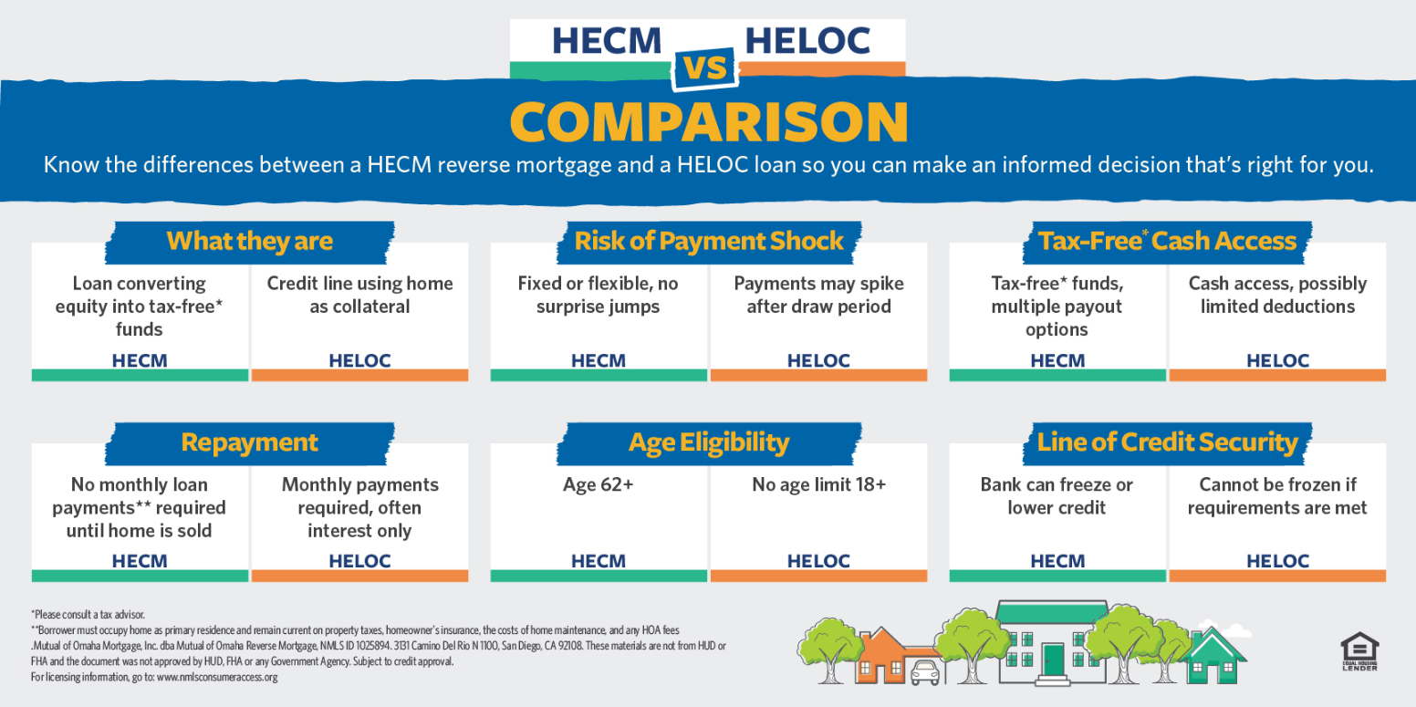

Slide 17
FAQs
How Do You Pay Off a Reverse Mortgage?
  Most reverse mortgages are paid off when the home is sold. The money made from selling the home is used to pay the loan balance.
  Borrowers are allowed to make early payments without penalty if they want, but it is not required.
What Happens to a Reverse Mortgage with regard to my Heirs?
  Option One: They can sell the home,
  repay the loan balance, and keep any
  of the remaining equity.
  Option Two: They can keep the home by repaying the loan, possibly by refinancing it into a new mortgage. If they choose to keep the home, repayment is limited to the lesser of the loan balance or 95% of its appraised value.

Slide 18
FAQs
What if the reverse mortgage loan is more than the market value of the home?
  A reverse mortgage is categorized as a non-recourse loan. This means that neither the borrower nor the heirs “will never owe more than the loan balance or the value of the property, whichever is less,” according to HUD.
  This also means that lenders can’t use other assets that belong to the borrower or to the borrower’s estate to settle the loan.
Who Owns the Home?
  The title continues to remain in the name
  of the borrower, just like with a traditional mortgage.
Are Reverse Mortgage Payments Taxable?
  The money received from a reverse mortgage is not taxable. Because the money received from a reverse mortgage is a “loan advance” and not income, it is not taxed*.
*Consult your tax advisor

Slide 19

NEXT STEPS
Schedule a free, no-obligation consultation
Personalized to your financial situation and goals
Review custom loan options
Start enjoying the life you’ve worked so hard for!

Slide 20

Borrower must occupy home as primary residence and remain current on property taxes, homeowner’s insurance, the costs of home maintenance, and any HOA fees.
Mutual of Omaha Mortgage, Inc. dba Mutual of Omaha Reverse Mortgage, NMLS ID 1025894. 3131 Camino Del Rio N 1100, San Diego, CA 92108. Alabama Consumer Credit License 22123; Alaska Broker/Lender License AK1025894. Arizona Mortgage Banker License 0926603; Arkansas Combination Mortgage Banker/Broker/Servicer License 109250; Licensed by the Department of Financial Protection & Innovation under the California Residential Mortgage Lending Act, License 4131356; Colorado Mortgage Registration 1025894; Connecticut Mortgage Lender License ML-1025894; Delaware Lender License 028515; District of Columbia Mortgage Dual Authority License MLB1025894; Florida Mortgage Lender Servicer License MLD1827; Georgia Mortgage Lender License/Registration 46648; Hawaii Mortgage Loan Originator Company License HI-1025894; Idaho Mortgage Broker/Lender License MBL-2081025894; Illinois Residential Mortgage Licensee MB.6761115; Indiana-DFI Mortgage Lending License 43321; Iowa Mortgage Banker License 2019-0119; Kansas Mortgage Company License MC.0025612; Kentucky Mortgage Company License MC707287; Louisiana Residential Mortgage Lending License 1025894; Maine Supervised Lender License 1025894; Maryland Mortgage Lender License 21678; Massachusetts Mortgage Broker and Lender License MC1025894; Michigan 1st Mortgage Broker/Lender/Servicer Registrant FR0022702; Minnesota Residential Mortgage Originator Exemption MN-OX-1025894; Mississippi Mortgage Lender 1025894; Missouri Mortgage Company License 21-2472; Montana Mortgage Broker and Lender License 1025894; Nebraska Mortgage Banker License 1025894; Nevada Exempt Company Registration 4830. Licensed by the New Hampshire Banking Department, Mortgage Banker License 19926-MB; Licensed by the New Jersey Banking and Insurance Department. New Jersey Residential Mortgage Lender License 1025894; New Mexico Mortgage Loan Company License 1025894; North Carolina Mortgage Lender License L-186305; North Dakota Money Broker License MB103387; Ohio Residential Mortgage Lending Act Certificate of Registration RM.804535.000; Oklahoma Mortgage Lender License ML012498; Oregon Mortgage Lending License ML- 5208; Pennsylvania Mortgage Lender License 72932; Rhode Island Lender License 20163229LL. Rhode Island Loan Broker License 20163230LB; South Carolina BFI Mortgage Lender/Servicer License MLS-1025894; South Dakota Mortgage Lender License ML.05253; Tennessee Mortgage License 190182; Texas Mortgage Banker Registration 1025894; Utah Mortgage Entity License 8928021; Vermont Lender License 6891; Virginia Mortgage Broker and Lender License, NMLS ID #1025894 (www.nmlsconsumeraccess.org); Washington Consumer Loan Company License CL-1025894; Wisconsin Mortgage Banker License 1025894BA; Wyoming Mortgage Lender/Broker License 3488. (866) 200-3210. Subject to Credit Approval.
Charges such as an origination fee, mortgage insurance premiums, closing costs and/or servicing fees may be assessed and will be added to the loan balance. As long as you comply with the terms of the loan, you retain title until you sell or transfer the property, and, therefore, you are responsible for paying property taxes, insurance and maintenance. Failing to pay these amounts may cause the loan to become immediately due and/or subject the property to a tax lien, other encumbrance or foreclosure. The loan balance grows over time, and interest is added to that balance. Interest on a reverse mortgage is not deductible from your income tax until you repay all or part of the interest on the loan. Although the loan is non-recourse, at the maturity of the loan, the lender will have a claim against your property and you or your heirs may need to sell the property in order to repay the loan, or use other assets to repay the loan in order to retain the property.
These materials are not from HUD or FHA and the document was not approved by HUD, FHA or any Government Agency. For licensing information, go to: www.nmlsconsumeraccess.org

Slide 21

NAME
Company name
Title
Phone:
Email:
Website:
21

