Slide 1

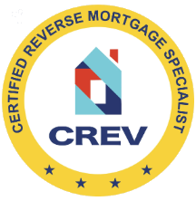



CERTIFIED REVERSE MORTGAGE SPECIALIST (CREV)
For professional use only. Not intended for consumer use.
v
October 2026
#4388450981
1

Slide 2


Housekeeping
We will break for lunch and have a break in the morning and afternoon, scheduled as appropriate.
A 50-question test will be sent to all participants after the session’s conclusion.
A passing score of 75% is required to receive your certification.

Slide 3

About the Presenter
Craig Barnes
Craig has more than 20 years of experience in the reverse mortgage industry. During that time, he has trained thousands of loan officers and operational professionals, helping elevate performance across all levels of the business. He has been a featured speaker at national mortgage conferences, authored multiple industry articles, and conducted countless webinars and university-style training sessions. Craig is a Certified Master Trainer through Development Dimensions International and has held the Certified Reverse Mortgage Professional (CRMP) designation for over 15 years. He also holds a degree in Business Education.

Slide 4
Course Agenda
Part I
The Market and Myths
Part II
Calculations
Part III
Borrowers and Properties
Part IV
After Closing
Part V
Part VI
Loan Flow
Selling Reverse Mortgages

Slide 5

The Market and the Myths
Forward vs. Reverse
Reverse Mortgage Basics
Reverse Products
AGENDA – PART I
5

Slide 6



THE MARKET AND THE MYTHS
6

Slide 7
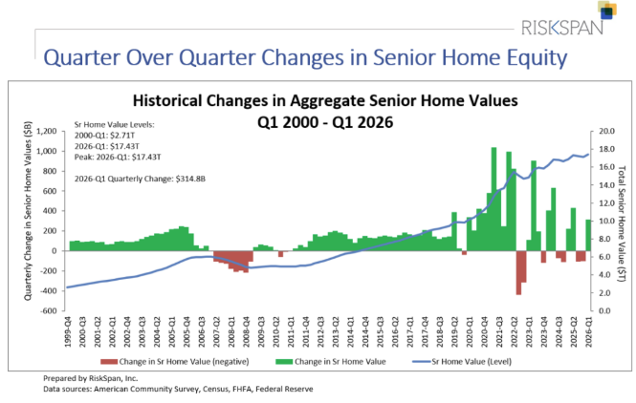
House Rich Cash Poor!
Peak 65 or Silver Tsunami
  Approximately 4.1 million Americans are expected to turn 65 through 2027.
Untapped Market
  Only 1.3 million households have utilized a reverse mortgage since the program’s inception.
Home Equity (62+) = >$14 trillion
Median Retirement Savings (65-74): $200,000
Notes:
https://www.cbsnews.com/news/retirement-medicare-401k-what-to-know-peak-65/
https://www.nerdwallet.com/article/investing/the-average-retirement-savings-by-age-and-why-you-need-more#:~:text=families%20is%20$333%2C940-,The%20Federal%20Reserve.,balances%20in%20the%20breakdown%20below.
https://www.nrmlaonline.org/about/press-releases/17828
Most seniors are not prepared for retirement without using their homes’ equity. Let their home “pay them back” after years of them working for their house. Even with 62+ AVERAGE retirement of just over $600k, do they have enough to live on for 20-30 years? What if there is a health care issue? What if they want to help their kids or grandkids?

Slide 8
Reverse Mortgage Market Penetration
Total Market Penetration
600K Units / 20MM = 3%
Annual Market Penetration
50K Units / 20MM = .2%
40MM
62+ Households
26MM
Homeowners
20MM
Equity & Property Qualified
14MM
Mortgage Free
600k
RM
Notes:
We have only scratched the surface.

Slide 9


Debunking the Myths
The bank gets your home
It is a last resort option
Heirs get stuck with a bill
I might outlive a reverse mortgage
Reverse mortgages are expensive
Notes:
These are some of the most popular, you may be thinking some are true, your friends, family and most importantly CUSTOMERS will.

Slide 10

The Bank Owns My Home
Free to sell the home at any time
  NO pre-payment penalty
Deed remains in borrower’s name*.
A lien on the property, without a REQUIRED monthly principal and interest payment.
All reverse mortgages are “non-recourse,” no deficiency judgements.
*Properties held in a Life Estate or Living Trust are generally allowable. Borrower must occupy home as primary residence and remain current on property taxes, homeowner's insurance, the costs of home maintenance, and any HOA fees.
Notes:
Do you have a mortgage on your home? Who owns it? No difference. Except on a reverse if you owe more than the value, you or your heirs aren’t on the hook.

Slide 11

I Don’t Need a Reverse Mortgage
Not just for needs-based borrowers:
Silver Divorce
Homecare
Social Security Deferment
Retirement Planning
  Drawing reverse funds when
  market is down
Reverse Purchase
Notes:
Not just a NEEDs product, yes, we can help those borrowers too.
Is your client drawing down their too quickly? Are they liquidating ?
Are they in need of homecare without long-term care insurance.

Slide 12

I Don’t Want To Leave Debt To My Kids
Remaining Equity | Wants to Retain Home? | Option
YES | Yes | Payoff loan balance
 | No | Sell the property and retain equity
NO | Yes | Purchase the home for 95% of appraised value
 | No | Deed in Lieu
Notes:
You don’t…
If the kids want to keep the home, they can, even if the market value is less than the loan balance. Can you do that with a forward loan?

Slide 13

What If I Outlive The Loan?
Give it a try! HUD guidance states that loans are due on the youngest borrower’s 150th birthday.
Non-Recourse means that the borrower will not owe more than the home is worth at the time it is sold.
Borrowers continue to be responsible for maintenance of the home as well as taxes and HOI.
Notes:
Lots of different dates on reverses.
Life Expectancy of youngest borrower – used for LESA, Asset and HECM Dissipation, TALC.
100th birthday – Amortization Schedule, tenure payments.
150th birthday – Note and Mortgage due dates.
Can the borrower be foreclosed on – yes, for the same reason they can in any other situation. They didn’t pay taxes or they don’t maintain their house.

Slide 14

I Hear Reverse Mortgages Are Expensive
As compared to what?
Don’t we all expect to pay more for premium products? Why not mortgages?
Value | Traditional Mortgage | Reverse Mortgage
No monthly P&I payments |  | ✓
Non-Recourse |  | ✓
Government insured (HECMs) |  | ✓
Unused LOC grows* |  | ✓
*On SEQ loans the LOC grows for 7 years.
Borrower must occupy home as primary residence and remain current on property taxes, homeowner's insurance, the costs of home maintenance, and any HOA fees.
Notes:
Mooney story. Premium product, premium features

Slide 15

Are there any penalties for paying off a reverse mortgage?
No. But if the balance is paid in full, the loan is closed.
15

Slide 16
FORWARD VS REVERSE
16

Slide 17
Traditional vs Reverse
Features | Traditional Mortgage | Reverse Mortgage
Purchase or Refinance Options |  | 
Lien On the Property |  | 
Fixed or Adjustable Rate |  | 
Borrower Owns the Home |  | 
Monthly Mortgage Payments | Required | Optional
Taxes & Insurance Payments | Required | Required
Property Maintenance | Required | Required
Debt & Equity | Falling Debt, Rising Equity | Rising Debt, Falling Equity
Total Amount Owed | Total amount you owe must be paid at time of payoff regardless of the home’s value. | Borrower/heirs never repay more than the value of the home at time of payoff (non-recourse) when the property is sold.
Prepayment Penalty | Possible | None
Notes:
Falling equity is a concerns for some, but partial prepayments can help avoid that, even just paying the interest can keep loan balance level and as property value rises, so does equity.

Slide 18
HECM vs SecureEquity®
Features | HECM | SecureEquity®
Product Description | Home Equity Conversion Mortgage | Proprietary or Private Reverse Mortgage (AKA Jumbo Reverse)
Federally Insured | Yes | No
Underwriting Guidelines | FHA | Mutual of Omaha
Home Value | None / $1,249,125 (2026) | $300,000/$10,000,000
Lending Limits | $936,844* | $4,000,000
Product Availability | Fixed and Adjustable | Fixed and Adjustable
Loan Type | Refinance, Purchase, Reverse Refinance | Refinance, Purchase, Reverse Refinance
Payment Options | Cashout, Monthly Payments, LOC | Cashout or LOC
LTV | Set by HUD | Set by Mutual of Omaha
DTI | Residual Income based on region and family size | Residual Income based on number of borrowers
Non-Recourse | Yes | Yes
*At lowest Expected Interest Rate for a 92 y/o with MCA of $1,249,125 or greater
Notes:
Today, estimates are that proprietary reverses are making up nearly half of the market, even more if you use loan amount as your barometer. They have many of the same protections as a HECM at a lower upfront cost and often have higher principal limits with less restrictions.

Slide 19

What You Need
Can the deal work? When you have a reverse lead and need numbers, you may have access to an LOS, but if you’re calling your reverse specialist…
Subtract 30 to 35 from the youngest borrower’s age!
You Don’t Need
FICOs DTI LTV
You Do Need
Youngest borrower age Estimated home value Payoff amount
Look at the credit report or ask about late payments. This will provide insight into whether a set aside for taxes and insurance may be needed.
Notes:
Reverse are liens on the property just like any other loan, but qualifications vary. When talking to your AE, just these 3 pieces of information can give you what you need to get started.

Slide 20
Mortgage Terms
REVERSE | FORWARD
Margin/Rate | Margin/Rate
Expected/ Initial Rate | Interest Rate
Interest Rate Cap | Rate Cap (ARMs/HELOCs)
Mortgage Insurance Premium (MIP) (HECM only) | Mortgage Insurance (FHA loans)
Maximum Claim Amount (MCA) | Appraised Value
Principal Limit | Maximum Loan Amount or LTV
Origination Fee | Origination Fee, Application Fee
Other Fees | Closing Costs
Life Expectancy Set Aside | Escrow Account
Available Funds/ Initial Disbursement Limit | Cash out
Tenure/Term | Monthly Payment
Mandatory Obligations | Total Payoffs
Initial Loan Balance (UPB) | N/A
Residual Income | DTI
Notes:
It’s the same, it not mysterious!

Slide 21
REVERSE BASICS
21
Notes:
More product variety and more “normalizing” of the product will help grow the market.

Slide 22
Reverse History
2025
Mutual rolls out our own proprietary SecureEquity®
Nelly Young – 1st RM borrower in US
Proprietary reverse products gain traction
HECMs in all states (N/A AK, SD&TX)
Jumbo Reverse Mortgages
HECM Fixed Rates
Financial Assess-ment
Non-Borrowers changes
HECM Saver
1961
1989
1993
1997
2003
2006
2007
2009
2010
2013
2015
2017
2018
2020
2021
2023
First HECM insured by FHA
NRMLA is founded
HECM Purchase _________________________________________ Record Volume
Program Changes
Lower PLFs, Change in UMIP
End of the LIBOR for HECMs
4000.1 updated with Publishes HECM guidelines __________________________________________
Improves H4P
New HECM products
_________________________________________
First HECM National Lending Limit - $417,000
Notes:
More product variety and more “normalizing” of the product will help grow the market.
Housing and Community Development Act - Signed by President Reagan

Slide 23
What Is A Reverse?
Non-Recourse
The house is the only source of repayment. No deficiency judgements against the borrowers, NBS, or heirs.
A non-recourse, negatively amortizing lien on a primary residence for senior Americans.
Negatively Amortizing
Since no monthly P&I are due, the loan balance increases.
Lien
A 1st position loan on the subject property. The deed does not change hands.
Primary Residence
Most reverses must be done on a residence where the borrower spends the majority of the year.
Senior Americans
Borrowers must be 62 (HECM) and 55 in most states on SEQ.
Notes:
Non-Recourse – Benefits to borrowers ans their HEIRS!
Always 1st position HECMs have a ghost 2nd too.

Slide 24
Reverse Basics
A mortgage that doesn’t require monthly mortgage payments*
  Same appraisal requirements as traditional loans
An equity release tool for borrowers 62+ (SecureEquity, 55+)
  Spouses can be younger
LTV determined by rate, value and youngest borrower’s age
  Older borrowers get a higher % of the value
  On HECMs, lower rates provide greater proceeds
  Rates change on Tuesdays
Almost all monthly ARM loans
  Borrowers can take proceeds in multiple ways. Over 90% take a growing line-of-credit.
For primary residences only
  Single family, FHA-approved condos, PUDs 2-4 families (1 unit owner-occupied)
*Borrower must occupy home as primary residence and remain current on property taxes, homeowner's insurance, the costs of home maintenance, and any HOA fees.
Notes:
No reason to be scared or intimidated – they are a mortgage, an FHA mortgage that doesn’t require monthly payments.
If you’re a borrower, you must be 62 but can be married to someone under 62 and non-borrowers can stay on title.
Avg 30 year fixed on 3/25/26 is 6.24% (Bankrate.com). The Note Rate on a HECM on the same day is 6.25% (2.00% margin).
Many of our clients cross-shop HELOCs, right now average rates are higher (7.04% on 3/25/26) but only one doesn’t require monthly payments
If the borrowers need steady income, they can choose a monthly payment for the live of loan and can change payment plans at anytime.
Primary residences are where they spend the majority of the year. You can only have 1 HECM at a time.

Slide 25

What happens if the loan balance becomes greater than the value of the home?
Nothing, all reverses are non-recourse. The home is the only source of repayment.
25
Notes:
Non-recourse debunks the myth of “The bank owns your house.”

Slide 26
REVERSE PRODUCTS
26

Slide 27
Reverse Loan Products
HECM
SecureEquity®
Adjustable-Rate Mortgages (ARMs) –Offered with a variety of margins.
  Note Rate based on the 1-year CMT index + a margin.
  Expected Rate (used to calculate Principal Limit) uses the 10-year CMT index + the same margin.
Fixed Rate (Closed End)
  Offered in a variety of rates.
  Proceeds taken as a full draw at closing.
Adjustable-Rate Mortgages (ARMs)
  Offered with a variety of margins.
    Rate based on the 1-year CMT index + a margin.
    Margins do not affect PL
Fixed Rate (Closed End)
    Offered in a variety of rates.
    Lower rate = lower PL
    Proceeds taken as a full draw at closing.
Notes:
99% of HECMs were ARMs in Fiscal year 2025.
93% were full LOC
Fixed not popular because of the lack of options and the restriction on amount of proceeds
SEQ Fixed plus are very popular due to the higher loan amounts and ability/requirement to draw all proceeds.

Slide 28
Disbursement Options
Line of Credit (ARMs only): Payments when the borrower requests a disbursement if there is an available LOC.
Lump Sum: Draw all the available funds at Closing. The only option available on fixed rate loans.
Tenure (HECM ARMs only): Equal monthly payments for as long as the borrower occupies the property as his or her primary residence.
Term (HECM ARMs only): Equal monthly payments over a fixed period.
Modified Tenure or Term (HECM ARMs only): Same characteristics as the term or tenure plan above adding a line of credit feature.
Rescission
Since most reverse mortgages are refinances, no funds are received at the Closing Table. Funds are disbursed on the 4th day.
28
Notes:
Borrower don’t make payments, they RECEIVE payments!
Lump Sum is only option on closed end products. HECM or SEQ
Unless borrower is purchasing, no money at the table, just like any other refinance – 3 day right of rescission

Slide 29
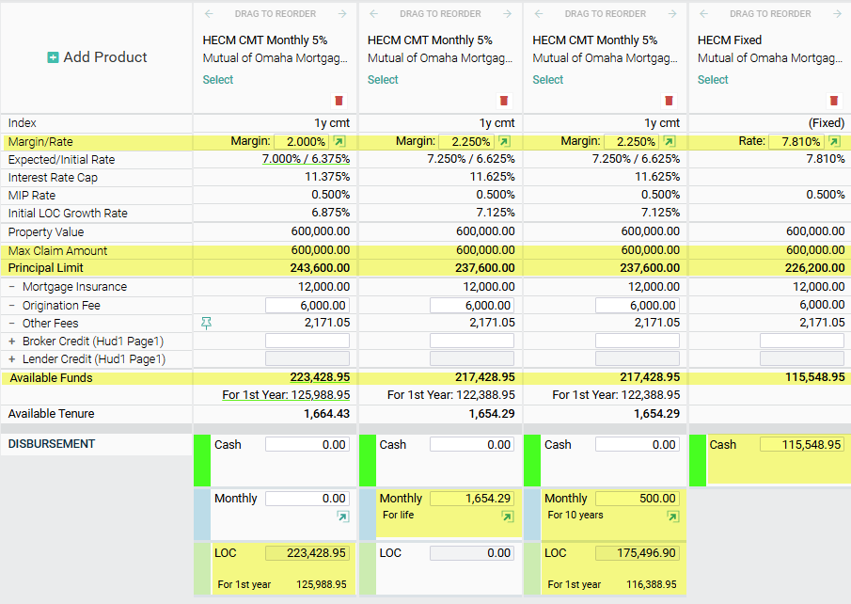
HECM Margins and Disbursements
Lower Margin, Higher PL
Most Popular Option – LOC
Tenure Payment
Modified Term
Cash-out (only option on Fixed)
Calculations based on a CA property on 9/28/26, 76-year-old borrower
Notes:
In Quantum you will only see the disbursement options available for the product.

Slide 30
HECM LOC VS HELOC
Loan Features | HELOC | HECM LOC
Increasing LOC | No | Yes
No monthly payments required (even interest only) | No | Yes
No resetting (monthly P&I payments required) | No | Yes
Can’t be frozen, lowered or called | No | Yes
Closing Costs | Not paid out of pocket | Not paid out of pocket
30

Slide 31
Finances Change, So Can Payments
LOC
Monthly Payments
After closing, borrowers can change how they receive loan proceeds.
  LOC ⬄ Monthly Payments
Available Principal Limit is recalculated.
$20 change fee is added to the loan balance.
Notes:
Obviously, this is for HECM ARMs only.
Borrowers are not locked into the payment plan they choose at closing

Slide 32
SecureEquity®
Sometimes called jumbos, proprietary reverse mortgages like SecureEquity® are not insured by HUD and are not called HECMs.
Although still non-recourse, SecureEquity ® does not charge upfront or ongoing MIP since they’re not HUD insured.
Possible uses:
  Higher loan amounts– often up to $4,000,000
  Younger borrowers – sometimes as young as 55*
  Unapproved condos – Condo CAN but are not required to be FHA approved.
  Closing Costs are an issue – No MIP
  Debt Consolidation – Can often pay off consumer debt
  Need for greater funds in year 1 – No IDL restrictions
  *Depending on state requirements
Notes:
We just had our first anniversary of our jumbo, SEQ.
We’re in 40 states right now.
Many of the negatives of a HECM are not in SEQ.
Higher values and loan amounts
Younger borrowers
No IDL restrictions
Debt consolidation

Slide 33
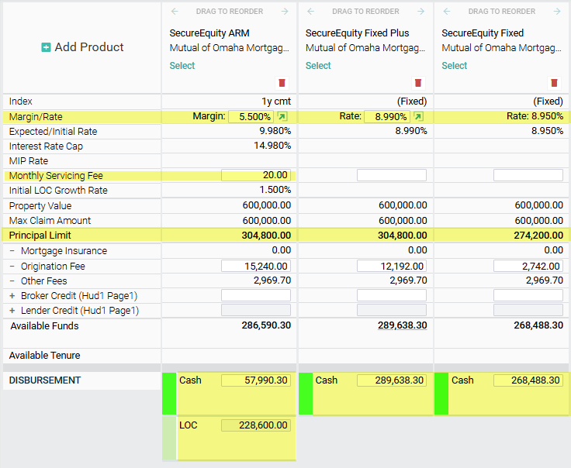
SecureEquity® Disbursements
ARMs - Margins don’t affect Principal Limit.
Fixed – Lower Rates will reduce Principal Limit.
ARMs require 25% initial draw.
Fixed require 100% draw
Calculations based on a CA property on 9/28/26, 76-year-old borrower
Notes:
Differences from HECM.
Margins don’t affect PL
LOWER rate on Fixed gives LESS proceeds.
Exceptions maybe allowed for less than 100% draw on Fixed

Slide 34
REVERSE REFINANCES
34

Slide 35
Why Refinance?
A borrower who has a reverse mortgage (HECM or other) and wants to refinance to a new reverse needs a “bona-fide benefit.” Common benefits include:
Access to more proceeds
  Property Value Increase
  Lending Limit Increase
Adding a borrower or eligible Non-Borrowing Spouse
  Borrower is now married and wants spouse to have Due and payable (D&P) protection (HECM only)
  An existing eligible NBS is now an eligible borrower
Lower rate (Fixed) or margin (ARM)
  New product availability
Reach out to your PSA or AE for assistance with
Notes:
Sometimes called H2H or R2R.
#1 reason is value has increased, so therefore they can receive more proceeds, and of course they have gotten older.

Slide 36
Refinance Eligibility
Original Borrower(s)
  New loan must have at least one original borrower.
  Eligible Non-Borrowing Spouses (HECMs only) on the original loan are not eligible for a refinance; it would be a new loan.
Loans in Default
  If the loan is in default for any reason (Taxes, Insurance, Repairs, Occupancy), the default must be cleared prior to closing the new loan without using proceeds from the new loan.
  Previous (cured) defaults do not affect refinance eligibility but may have financial assessment implications.
Bona-fide Benefit
  Additional proceeds, lowering an interest rate, or adding a borrower are the most common.
  New loan should pass all refinance tests, if not an exception must
  be granted.
Unless an exception is granted reverse refinances require 12-month seasoning
Notes:
4000.1 Page 758: When the HECM is in a deferred Due and Payable status, due to the death of all Borrowers, and the Eligible Non-Borrowing Spouse (NBS) seeks to obtain a HECM as a Borrower on the Property serving as collateral for the existing HECM, the transaction cannot be originated as a HECM Refinance, but must be originated as a traditional transaction provided that all Borrower eligibility requirements are met.
4000.1 Page 760: At least one Borrower from the original HECM must be a Borrower on the HECM Refinance for the transaction to be eligible for reduced Initial Mortgage Insurance Premium (IMIP).

Slide 37
Reverse Refinances – Fees and Services
Services are required for the new reverse regardless of how long it has been since closing the current reverse.
Closing costs are the same as traditional refinances.
  Credits allowed on ARM loans
  HECMs - Up-front MIP (UMIP) will be reduced based on what was paid on the current loan.
To calculate a benefit, you will need:
  The original Maximum Claim Amount, existing loan’s Current Principal Limit, and payoff.
  Existing loan’s margin (or rate on fixed)
  Other information (adding a borrower or spouse, removing a servicing fee)
Fees and Counseling
All services (except for the credit report) must be dated after counseling
Calculating the Benefit - Documents
Monthly Statement (all pages) contains the needed information to calculate initial benefits.
Refinance Worksheet and Payoff Letter - determines final numbers.
LOEs explain the desire for refinance.
Notes:
Fees other than MIP are the same. The borrower almost always must be counseled again (always if getting a SEQ)
Monthly statement can provide a lot of the information you need.
Your sales team can assist too, with a Case Query

Slide 38
Refinance Tests
Closings Cost Test – increase in principal limit should be at least 5x the closing.
Reach out to your PSA or AE for assistance with the refinance tests
Current PL | Proposed PL | Increase | Closing Costs | CC x 5 | CC Test
$250,000 | $325,000 | $75,000 | $10,000 | $50,000 | Pass
Loan Proceeds Test – available proceeds should be at least 5% of the new principal limit.
Proposed PL | Payoff | Closing Costs | 5% PL | Available Proceeds | Loan Proceeds Test
$325,000 | $285,000 | $10,000 | $16,250 | $35,000 | Pass
Loan Type Test – the benefit must be greater than switching from a fixed to ARM or ARM to fixed.
Notes:
If one of the tests don’t pass, it’s usually the CC. Reducing Orig. Fee, lowering the margin and/or offering a credit can help..

Slide 39
Monthly Statement – Provides current information that can estimate the monetary tests and possibly seasoning.
Anti-Churning Disclosure – Required on all HECM refinances. Provides calculations for monetary tests.
HECM Refinance Worksheet – Provides the final numbers used to calculate all benefits. Should be ordered later in the process.
Payoff Statement – Provide payoff balance including good-thru dates and per-diem interest.
Get a copy early!
Part of Application Package
Required for final approval
Usually included with worksheet
Notes:
Just like paying off any other loan, a payoff letter is required that has good-thru dates, daily interest amounts, etc.
Requesting this from the current lender MAY mean a call to your client – be prepared. Not at Mutual. Broker Protect!

Slide 40
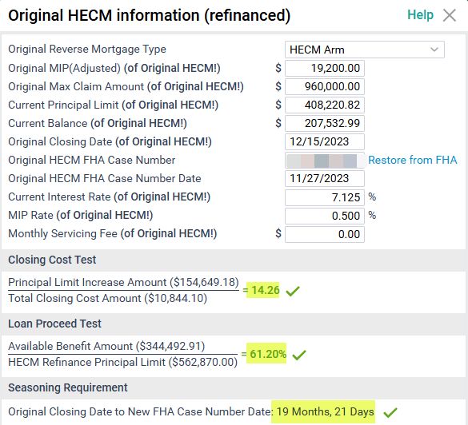
HECM Refinance Example - More Cash, Lower Margin
Mrs. Alexander’s home value has increased by over $200k since closing her last HECM and her margin is over 3%.
Closing Cost Test
Principal Limit | Closing Costs | 5x CC
$562,970-$408,221=$154,749 | $10,844x5=$54,220 | ✓
Loan Proceeds Test
Principal Limit | Available Benefit Amount | 5% of Proceeds
$562,970 | $344,493 (61%) | ✓
MIP
MIP on Current Loan | Available Benefit Amount | MIP on New Loan
$19,200 | $230,000 x 3% = $6,900 | $0
Counseling Waiver*
Anti-Churning - ✓ | 5 Years or Less - ✓ | 5x Closing Costs - ✓
Seasoning
Greater than 12 months since closing last reverse - ✓
*Waiver is only available on HECMs and is state dependent.
Notes:
Loan (Real)
Loan # 10546463
New MCA $1,190,000
75 Year Old

Slide 41
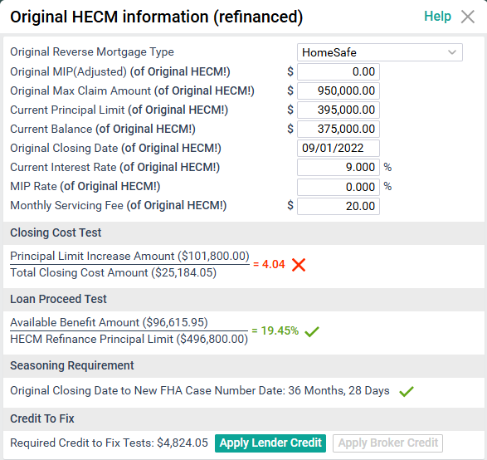
SecureEquity+ Example
Mrs. Ward closed a competitor’s jumbo reverse a few years ago. She’s looking for cash to pay for in home medical care.
Closing Cost Test
Principal Limit | Closing Costs | 5x CC
$496,800 - $395,000 = $101,800 | $23,514 x 5 = $117,570 | X
Loan Proceeds Test
Principal Limit | Available Benefit Amount | 5% of Proceeds
$496,800 | $96,616 (19.5%) | ✓
MIP
MIP on Current Loan | Available Benefit Amount | MIP on New Loan
N/A – No MIP on Secure Equity
Counseling Waiver*
No Counseling Waivers on Proprietary Refinances
Seasoning or Additional Benefit
Greater than 12 months since closing last reverse - ✓
Medical Necessity - ✓
Remove Monthly Service Fee - ✓
Notes:
Loan # 10604889
$1,200,000
63 Year old

Slide 42
REVERSE PURCHASE
42

Slide 43


Reverse Purchases
More house, same money
More square footage/better lot
More upgrades
Better location
More house, less money
Existing portfolio remains intact
Invest sale proceed for future use
Notes:
Many people don’t even know you can BUY a house with a reverse.
Not everyone over 55 is in their forever home already. Many do want to age in place, but not necessarily in the home they’re in right now.
Maybe they think they can’t afford that dream retirement home, or they don’t want a mortgage payment!

Slide 44
Reverse Purchases
Great products for borrowers who are downsizing or rightsizing.
Gives borrowers ability to upgrade their purchase.
Always requires a borrower investment, typically 40-60%.
Principal Limit calculated the same a traditional reverse.
Up to a 6% Interested Party Contribution is allowed towards Closing Costs.
Seller paid closing costs are allowed when reasonable and customary for the market
Notes:
Not for 1st time homebuyers or those who have 3-20% down.
Borrowers other option is often to pay cash.

Slide 45
Down Payment Matrix
Many reverse purchase buyers begin as all-cash buyer. The chart below illustrated how much more house a buyer can get using a Reverse Purchase.
AGE | Purchase Price | $400,000 | $500,000 | $600,000 | $750,000
 |  | Cash required*
 | 62 | $292,798 | $364,040 | $435,284 | $542,149
 | 67 | $277,998 | $345,540 | $413,084 | $514,399
 | 71 | $269,598 | $335,040 | $400,484 | $498,649
 | 75 | $257,598 | $320,040 | $382,484 | $476,149
*The amounts displayed are for illustrative purposes only. Actual down payment amounts may vary based on interest rate and other factors. Please contact us for details about credit costs and terms. Expected Rate of 7.0% for CA property 9/25/26
Notes:
Found the house, have the cash but may need to liquidate retirement to avoid a mortgage.
Can’t find the house in their budget, how about upping the budget by 30-50%?

Slide 46
Purchases vs. Refinances
Principal Limit same as a refinance
Lower of Sales Price or Appraised Value
Occupancy within 60 days of Closing
No Repair Set Asides
  Repairs must be completed by the seller, prior to Closing
Must have established credit
Notes:
PLs are same but if appraised value is less than the sales price – lesser of the 2.
Repairs noted on appraisal must be don prior to close.
No Trad credit must be run or established.

Slide 47
Seller Concessions & Allowable Fees
Interested Party Contributions vs. Seller Concessions
Who are “Interested Parties”
Interested Parties Include:
Sellers, real estate agents, builders, developers. Lenders or brokers are not allowed to provide contributions. Premium pricing, discount points, and rate buy-downs are not allowed.
Allowed* Interested Party Contributions (Up to 6% of Sales Price) | Not Allowed* Seller Concessions
All closing costs (less counseling fee) including Origination Fee, MIP and | Allowances for upgrades, repairs, design or decorating
Prepaid items | Value of personal property
Transfer Tax | Rent credit
RE Commissions | Moving costs
 | Commissions on departing home
 | Contributions > 6% of Sales price
 | Contributions > Closing Costs (less counseling)
*Not an exhaustive list.
Sales contract which includes seller concessions must be amended. Sellers can provide a credit towards Closing Costs.
Notes:
Brokers or lender cannot provide the IPCs.
The 6% should be a credit towards CC.
If over 6%, are the fees included R&C?

Slide 48
Contract of Sale
Expiration Date
  Is there time to Underwrite, Clear Conditions and Close?
  Rush Request?
Seller Concessions
  Cannot be listed in contract
Interested Party Contributions
  Cannot be from lenders or partners
  No more than 6% of Sales Price
  R&C fees typically paid by the seller do not need to be included
Amendatory Clause and Real Estate Certification
  Cannot be waived on HECMs
  Not required on SecureEquity®
Notes:
Lot of parties involved with a purchase. A smooth process can mean repeat business from builders and realtors.
Important to know the contract – dates, concessions.

Slide 49
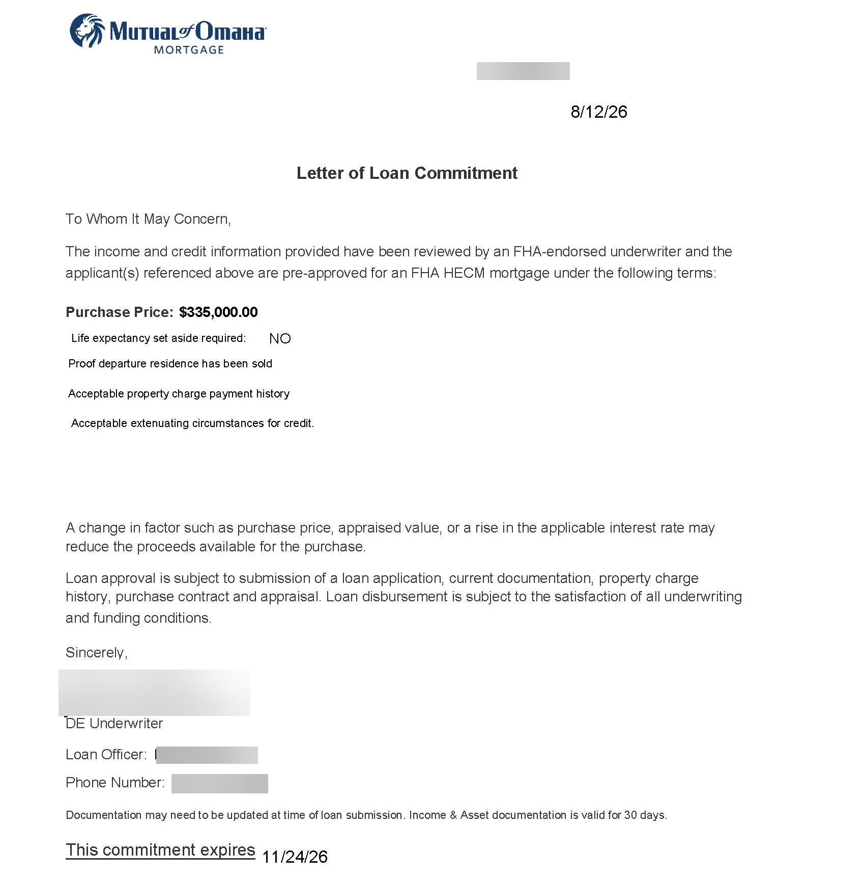
Reverse Purchase Pre-approval Letter

Slide 50

Reverse Purchase loans require _______ within 60 days of Closing.
Occupancy
50

Slide 51
AGENDA – PART II
Calculations
Principal Limit Growth
Fees
51

Slide 52
REVERSE CALCULATIONS
52

Slide 53
Maximum Loan Amount (Principal Limit)
HECMs
Max Claim Amount
Current Appraised Value or National Lending Limit (2026 - $1,249,125) whichever is less
Principal Limit Factor
Table published by HUD based on the youngest borrower’s (or ENBS) age and current Expected Interest Rate.
Principal Limit
The maximum amount that you can lend.
X
=
SecureEquity®
MCA (Appraised Value)
Up to $10,000,000
Principal Limit Factor
Table published by Mutual of Omaha Reverse based on the youngest borrower’s age and product.
Principal Limit
The maximum amount that we lend. Max Principal Limit is $4,000,000
X
=
Notes:
HECMs are based on PL tables published at Hud.gov
Homes that are worth over the national limit on a HECM mean they are leaving equity on the table. Same on SEQ for values over 10mm

Slide 54
Principal Limit – HECM
Three Factors
  Youngest borrower or eligible non-borrowing spouse’s age
    Older Borrowers = Higher Proceeds
    Birthday Rule (within 6 months of Closing)
  Expected Interest Rate
    Lower Rate = Higher Proceeds
    Effective Interest Rate Floor of 3.0%
    Rounded to nearest 1/8th
  Max Claim Amount (home value or national lending limit)
HUD changes PLFs from time to time
  Last change - October 2017
10-year CMT week of 9/25/26, 4.99%.
  To see the table, click HERE
Notes:
PLFs are often discussed as something to lower to make the program “break even.”
Have not changed since 10/17

Slide 55
10 Year CMT and 1 Year CMT
HECM ARMs
Initial Rate – 1 Year Constant Maturity Treasury (CMT)
  Does NOT get locked, floats until closing.
  Becomes the Note Rate
Expected Rate – 10 Year CMT
  Principal Limit
  Projections before Closing
SecureEquity®
  Uses the initial rate for all purposes
Notes:
Average Rates
https://www.federalreserve.gov/datadownload/Download.aspx?rel=H15&series=a75a8767fe9c79547bd59ae9cc5870b2&lastObs=&from=01/01/2004&to=12/31/2025&filetype=spreadsheetml&label=include&layout=seriescolumn

Slide 56
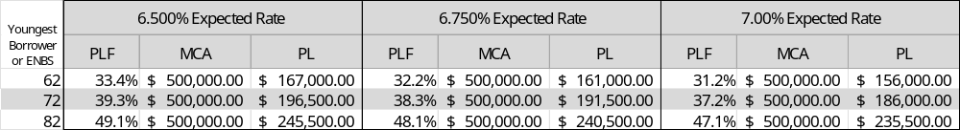
HECM Principal Limits
The largest Principal Limit = $936,844 (max PLF is 75%)
70 and 71-year-olds have same PLF at almost all rates
Max PLF at ages 92-97
Expected Rates are rounded to the NEAREST 1/8th (0.125)
  5.560%  5.500%
  5.570%  5.625%
Subtract 30 to 35 from the youngest borrower’s age.
Notes:
3% age 92 - 75% PLF highest % Highest PL = $936,844 (max PLF is 75%) 2026
At
At 3% ER borrower maximizes PL at 92
4% ER borrower maximizes PL at 95
5% ER borrower maximizes PL at 97

Slide 57
Calculating the Initial LOC
Although after Closing the Note Rate is used for calculation, the initial LOC uses the Expected Interest Rate (EIR) to calculate the initial LOC.
57

Slide 58
How is the Initial LOC Established?
Calculating the initial LOC starts by subtracting the following from the Principal Limit:
  Mandatory Obligations (MOs)
  Cash out
  Monthly payments
  LESA
  Repair Set Asides
The remaining Principal Limit is the beginning LOC available.
58

Slide 59

Initial Distribution (HECM Only)
50% is the Magic Number
All HECMs are subject to Initial Distribution
Limits.
  50% or of PL = up to 60% of PL
  ⇧ 50% = 10% of PL
What reduces IDL?
  Cash at Closing
  1st Year Tenure or Term payment
  1st Year payments
Fixed rates can only take IDL funds at Closing. May end up leaving money on the table.
PL - $200,000
Up to 60%
Payoffs - $0
Closing Costs - 20,000
1st Year - $100,000
Flat 10%
Payoffs - $100,000 Closing Costs - $20,000
1st Year - $20,000
Notes:
Confusing to some. Meant to help programs and loan sustainability. Assures that the borrower doesn’t use all proceeds at once.
Most HECMs are over 50% drawn so borrower can get 10% at Closing or in year 1. Made Fixed very unpopular, no payment options AND potential of leaving $ on the table

Slide 60
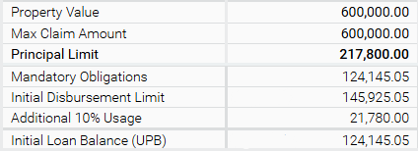
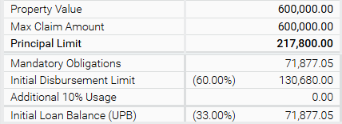
IDL Example (HECM only)
50% or Higher
MOs - 57% of PL
Can draw up to 10% of PL in 1st year
Amount reduced by cashout, 1st year monthly payments or
50% or Lower
MOs - 33% of PL
Can draw up to 27% (60% total) of PL in 1st year.
Amount reduced by cashout, 1st year monthly payments or
Notes:
No waivers, no exceptions

Slide 61

Principal Limit – SecureEquity®
Four Factors:
  Youngest borrower’s age
    Older Borrowers = Higher Proceeds
    Birthday Rule (within 6 months of Closing)
  Product
    Higher PLs on ARM and SEQ Fixed+
  Interest Rate (SEQ Fixed Only)
    Lower Rate = Lower Proceeds
  Appraised Value (up to $10,000,000)
Notes:
Much easier, no IDL restrictions. ARM margins don’t affect PL, on Fixed Lower rates = lower PLs, opposite of HECMs

Slide 62
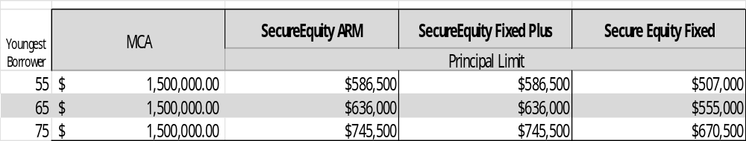
SecureEquity® Principal Limits
The maximum Principal Limit = $4,000,000
Interest rates do not affect PL on SEQ ARMs
Lower rates will reduce PL on SEQ Fixed
Notes:
Sample PLs are based on 9/28/26

Slide 63
REVERSE FEES
63

Slide 64
Reverse Mortgage Fees
 | HECM | Secure Equity
Loan Origination Fee | Up to $6,000 (depends on MCA) | Depends on Loan Amount
3rd Party Closing Costs | Typical fees (appraisal, title, recording fees, settlement, notary, credit report and flood certificate, state specific, etc.)
Counseling | $150-$200 (maybe less for agencies with grant funds) | $150-$200
Upfront Mortgage Insurance Premium | Currently 2% of MCA | $0
Ongoing MIP | Currently 0.5% of loan balance annually | $0
Fees are almost always rolled into the loan balance. Borrowers generally pay for counseling and appraisal out of pocket.
Notes:
Closing Cost are like any other loans, but MIP and Origination Fee.
Most (99%) finance CC into loan

Slide 65
Origination Fees
2% of the first $200,000 of MCA
1% of MCA greater than $200,000
Maximum Origination Fee = $6,000
Minimum of $2,500* (properties <$125,000)
Can be reduced to $0 (ARMs)
SecureEquity®
ARMs - Lesser of 5% of Principal Limit or $60,000, minimum of $0 payable to broker.
Fixed - 1% of Principal Limit payable to lender Cap of $30,000.
Fixed Plus - 2-4% of Principal Limit payable to lender Cap of $30,000
MCA/Appraised Value |  | $100,000 | $150,000 | $300,000 | $400,000
2% of first $200k |  | $2,500* | $3,000 | $4,000 | $4,000
1% MCA >$200k (max $6,000) | + | $0 | $0 | $1,000 | $2,000
Origination Fee | = | $2,500* | $3,000 | $5,000 | $6,000

Slide 66
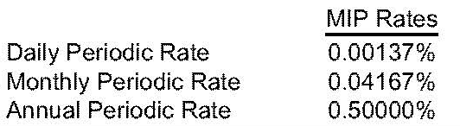
MIP (HECM only)
Ongoing MIP
.5% of loan balance annually
Added to loan balance each month (1/12)
Upfront MIP
$600,000
x 2%
$12,000
Treated as a Closing Cost
Notes:
This is from a monthly statement

Slide 67

If a borrower’s PL is $200,000 and their mandatory obligations are $120,000, how much can they draw in the first year?
$20,000, 10% of Principal Limit.
67

Slide 68
PRINCIPAL LIMIT GROWTH
(HECM ONLY)
68

Slide 69
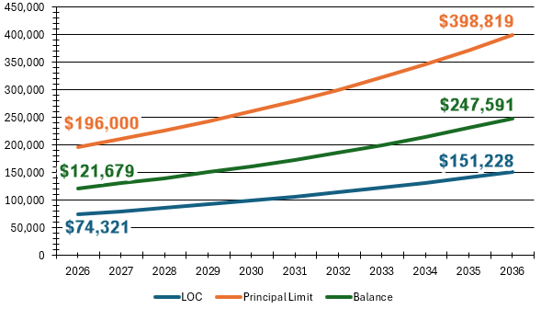
Principal Limit Growth – HECMs
Principal Limit grows at the loan’s Note Rate + .5% annually.
Unused LOC funds continue to grow.
Partial prepayments lower the balance and therefore increases the LOC.
Assumes a 6.5% growth rate
Notes:
These are projections, remember these are ARMs. This week this would be a Note rate with a 2.25% margin with the .5% ongoing MIP

Slide 70


Always Growing
Interest rates effect loan growth
Higher rates = more growth
Lower rates = slower growth
What happens when rates decrease?
Even if the 1-year CMT went to zero, growth is still calculated using the margin + ongoing MIP
Notes:
Today’s rates make it frustrating for us all because we can’t get the levels of PL we say just a short time ago, therefore we can’t help as many clients. The other side of the coin is that we are seeing the fastest line of credit growth in history.
You will always have the “what if” borrower. “Rates are not going to stay this high.” What if the RE market crashes, etc. We don’t use the word “guaranteed,” but even if the index went to zero, the LOC would still grow at the margin + 0.5%. And another “guarantee” - not only will the LOC grow but, unlike a HELOC it can’t be frozen or pulled back!
20 years: https://fred.stlouisfed.org/series/DGS1 2007 average 1-CMT 4.52

Slide 71
What Makes Up Principal Limit?
All growth is based on an increasing Principal Limit over the life of the loan.
Note Rate + 0.5% annually
The higher the rate the faster the growth.
The increase in PL is seen in the LOC, and monthly payments.
Notes:
Loan balance is the total of Principal, Interest and ongoing MIP.
PL always is the whole and must be accounted for

Slide 72
When Does The Borrower See The Growth?
Just like the loan balance, the LOC growth is shown on each monthly statement. Allowing the borrower to “use” 1/12 of the annual growth.
Notes:
Even though we discuss and show “annual numbers,” the borrowers will see (and can use) 1/12 of that growth each month. Let’s see it…72

Slide 73
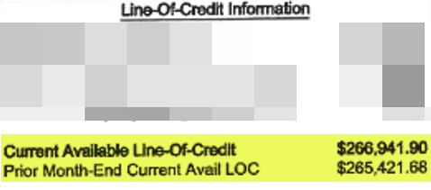
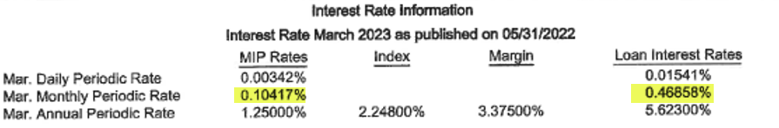
Calculating Monthly LOC Growth
Just like the loan balance, the LOC growth is shown on each monthly statement. Allowing the borrower to “use” 1/12 of the annual growth.
Prior Month LOC |  | Monthly Growth Rate | Current Available LOC
$265,421.68 | x | 0.57275% (0.46858 + 0.10417) | $266,941.90
That’s $1520 of growth in 1 month – that’s $49 per day
Notes:
Here are the numbers from a recent statement…, not so recent

Slide 74
Partial Prepayments
Partial repayments on ARM loans go directly to reducing the loan balance and increasing the LOC.
The “Prepayment Waterfall” how prepays are applied for tax purposes.
    Accrued MIP
    Accrued monthly service fees (if app.)
    Accrued interest
    Principal
When a repayment is made on a closed-end product, funds cannot be re-drawn.
Consult a tax advisor for interest deductibility.

Slide 75
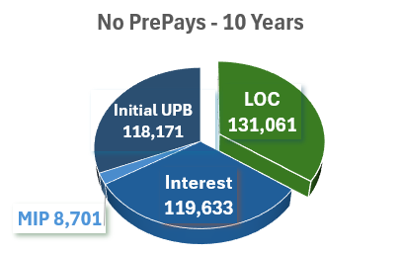
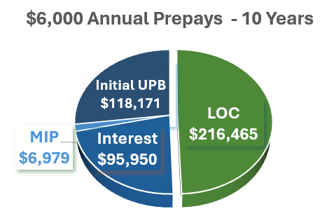
Prepays vs. No Prepays
100% of the Principal Limit is always allocated to one of the categories (slices). Prepayments reallocate those slices.
Initial Principal Limit - $181,000
Projected Principal Limit* - $377,564
LOC  - $85,405
Balance  $85,405
Interest  $23,683
MIP  $1722
*Expected Interest Rate 6.75%

Slide 76
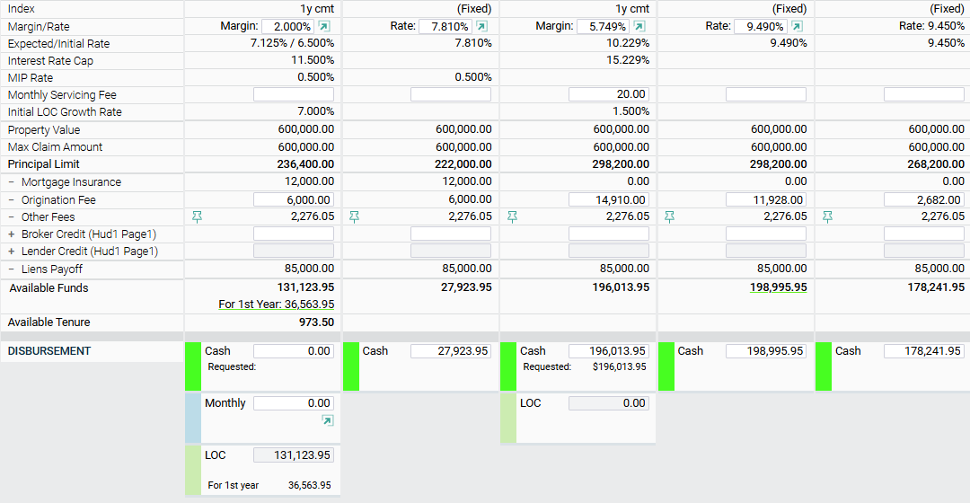
Calculations Review
HECM Cap 5 HECM Fixed SEQ ARM SEQ Fixed Plus SEQ Fixed
75 Y/O, California property 10/1/26
Notes:
75 year old borrower in California – 2/25/26
Review each number and compare to other products
Discuss difference between value and MCA
Review how PLs are different from each other
How to lower origination fees and what a broker CAN reduce

Slide 77

On a HECM, if the index was 3.00% and the margin was 2.00%, what would the PL growth rate be?
2.00%
5.5%
3.00%
None of the above
B – 5.5%
77

Slide 78
AGENDA – PART III
Borrowers
  Non-Borrowers
  Income and Credit
  LESAs
Counseling
Property
  Property Types
  Appraisal guidelines
  Repairs
78

Slide 79
BORROWERS, NON-BORROWERS, AND POAS
79

Slide 80
Borrowers
To be a HECM borrower, you must be 62.
  SecureEquity® allows 55-year-old borrowers in most states.
Principal Limit determined by age of youngest borrower or eligible NBS (HECM only).
  Older borrowers get a higher percentage of their home’s value.
Non-borrowing spouses can be as young as 18.
  NBS’ can remain on title but are not borrowers
The birthday rule allows for more proceeds when their birthday is within 6 months of Closing.
Notes:
You only need 1 borrower, others can be NBS.
PLs increase until 92-95
No need to quit claim
SEQ has no “eligible” NBS

Slide 81

Borrower Protections
Reverse mortgages are non-recourse loans
Mandated counseling
No prepayment penalty
Pre-counseling, application and closing disclosures. As well as required redisclosing
Fixed rates or interest rate caps
Origination fee caps
Protection for Non-Borrowing Spouses (HECMs)
Analysis of capacity and willingness to ensure sustainability
Notes:
Protected class

Slide 82
Types of Non-Borrowers
All borrowers, Non-Borrowing Spouse and non-borrowing owners must attend counseling, including those who are being removed from title at Closing.
Non-Borrowing resident’s residual income can be used to reduce family size when needed.
 | Resides in the Subject Property | On Title | Counseling Required | Disclosures Required
NB/Spouse | Yes/No* | No | Yes | Yes
NB Owner/Spouse | Yes/No* | Yes | Yes | Yes
NB Household Member | Yes | No | No | No
NB Household Member/Owner | Yes | Yes | Yes | Yes
NB Owner | No | Yes | Yes | Yes
*Non-borrowing/Common-law spouses who do not live in the home are ineligible for a deferral period.
Notes:
Everyone with ownership interest must be counseled and sign docs – docs vary by state and product.

Slide 83
Non-Borrowing Spouses (NBS) – HECMs
PL factors are determined by the age of the youngest borrower or eligible NBS.
Ineligible spouses must show they do not live in the subject property.
All NBSs must have a verified SS# and birthdate.
Legally separated spouses are considered married
Only ineligible NBSs are permitted in Texas.
Be married at the time of Closing
Occupy the subject property for the duration of the loan
Be married at the time the D&P event occurred
Protected (Eligible) Non-Borrowing Spouse
Notes:
NBS that meet the criteria MAY BE eligible for a deferral of the D&P event that would normally occur when the last borrower passes away or goes into a nursing home.
This is only for HECMs.
Eligibility is not optional, the NBS either meets the criteria or not.

Slide 84
Eligible vs Ineligible Examples
Legally married couple
Both live in the subject property
Only one is 62+
Only borrower on deed to property
Legally married couple
Permanently living apart
Only one is 62+
Both on deed to property
Couple together for 20 years*
Both live in the subject property
Only one is 62+
Both on deed to property
Legally separated couple
Both living in the subject property
Only one is 62+
Both on deed to property
Mother and Daughter
Both living in subject property
Only mother is 62+
Only mother on deed to property
Eligible NBS
Ineligible NBS
NB Owner
Eligible NBS
NO, NO, NO!
* Maybe an ENBS in states that recognize Common Law marriages

Slide 85
NBS – Deferral Period (HECMs)
The deferral period applies upon death, or due to the
borrower residing in a health care facility for more than
12 consecutive months. This “defers” the due and
payable event.
Only eligible (protected) non-borrowing spouses can
stay in the home when this occurs.
Borrowers with estranged spouses that do not occupy
the property as their primary residence do not qualify
for the deferral period.
All NBS will be required to complete an annual
occupancy certification during the deferral period.
SecureEquity®
No Deferral Period for NBS
Occupying NBSs, NBSs on Title must attend videotaped interview with attorney of their choosing. Also required for NBSs in community property states.
Notes:
Ineligible at closing can never become eligible.

Slide 86
NBS – Responsibilities During Deferral (HECMs)
NBS must ensure all obligations of the HECM
borrower continue to be satisfied:
  Payment of taxes and insurance
  Maintenance of the property
  Occupancy
No payments* will be made to the NBS during the deferral period:
  Tenure/term payments
  LOC draws
  LESA payments
*Only payments from repair set asides can be made
Notes:
Cannot lend funds to non-borrowers

Slide 87
General POA Guidelines
The POA document must:
Durable* (continues in effect if the borrower becomes incapacitated)
Gives the right to encumber the property
Executed by a competent borrower
Executed by the borrower prior to the date of counseling and application
Can be revocable or irrevocable
Must meet all state requirements
Title must provide POA approval
*No “temporary” POA’s are allowable (unless being used solely for closing). Only payments from repair set asides can be made
  The Power of Attorney (POA) must attend counseling and sign the counseling certificate in all cases.
  Attorney-in-Fact to execute a POA Affidavit at closing
  The application and closing documents, must follow the guidelines in the POA document, typically: Jane Smith, by John Doe as attorney in fact.” John Doe is the POA, Jane is the borrower
Notes:
Few important things to keep in mind.
The date the POA was executed is important when there are competency issues.
We need a copy of the POA.

Slide 88
POA Scenarios
POA at Closing Only
Borrower(s) must have executed entire application package and counseling certificate
Competent but POA signing app and closing
Borrower must sign the initial application 1009 and HUD92900A
Competent Physically Incapable
Current physician’s letter confirming only physical incapacitation is required
Mentally Incompetent
Borrower must provide a signed letter of explanation indicating the reason for using the POA for closing only
Borrower & POA must attend/participate in counseling and sign the counseling certificate
Borrower to provide a signed LOE giving the reason for using POA to sign on their behalf
POA can sign all other application disclosures and closing docs
Processor to obtain an email, or signed and dated letter from Counselor, certifying that the borrower(s) attended counseling
Borrower must still attend/participate in counseling along with the POA (borrower is not required to sign the counseling cert)
POA signs all application, counseling and closing documents
A doctor’s letter is required to certify that the borrower is no longer capable of handling his or her own financial affairs. This letter must include the date the borrower became incapable of handling his/her financial affairs. The date on the doctor’s letter must be current. If the borrower signed the POA SHORTLY before the application date, the letter should verify that the borrower was capable of handling financial affairs as of the date the POA was executed. (Two doctors may be required depending on POA verbiage)
The borrower must have clearly executed the power of attorney when the borrower was still competent
POA attends counseling on behalf of the borrower
POA signs all application and closing documents
Notes:
Doctor’s will not say an exact date when someone “became” incompetent. Phrases like, “When I last saw them,” “They started exhibiting signs.” Depending on those time frames and when the POA was executed will determine if a 2nd letter is needed or if the POA can be used.

Slide 89

A married couple ages 65 and 60 living together when the 60-year-old passes away. What happens to their reverse mortgages?
Nothing, a reverse mortgage is due and payable when the last borrower passes away. The 60-year-old was a NBS.
89

Slide 90
INCOME AND CREDIT
90

Slide 91
Income Guidelines
Must meet Residual Income requirements
Most types of legally derived and documented income can be used.
  Most Popular: Social Security, Pension, Employment, IRA, 401(k)
  Non-taxable forms of income can’t be grossed up
Asset Dissipation and Compensating Factors used when income does not meet requirements.
HINT! Start with income that’s easy to document and provide just enough income to meet RI. No need for ALL income or tax returns unless required.
SecureEquity®
The same sources of income are allowed.
Asset Dissipation and Comp Factors are allowed.
Residual Income is calculated based on the numbers of borrowers only.
Notes:
Income is verified to ensure they have enough income after their expenses are paid to make the reverse a sustainable loan after Closing.

Slide 92
Income Documents
Employment – 2 months paystubs (most recent 30 days that shows year to date earnings) & VOE within 10 days of funding
Self Employment Income – last 2 years personal and business tax returns & all schedules
Retirement Income – Most recent month’s bank statement reflecting deposit & award letter
Social Security Income – SSA Award Letter or SSA-1099 or Benefit Letter and 1040s and bank statement reflecting deposit
VA Benefits – VA letter or distribution from VA that shows end or event date (3 year minimum)
Rental Income – Copy of lease & 2-year tax returns with Schedule E
Notes:
Income is reviewed like any other FHA loan.
3 years continuance
No tax returns if you can help it.
Ask about

Slide 93
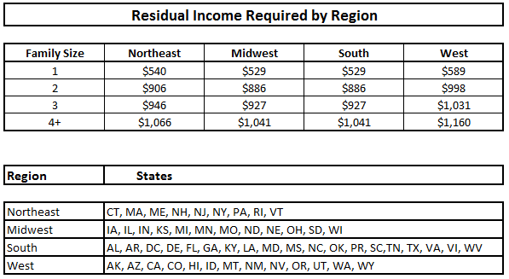
Capacity Test
Example:
Total monthly income: $2,500
Monthly property charges: - $500
Minus other expenses: - $800
  Installment, credit card minimums, other debt
  14 cents per square foot
Residual income: = $1,200
SecureEquity®
Residual Income is calculated based on the numbers of borrowers only.
1 Borrower - $750, 2+ Borrowers - $1,000
SecureEquity® Streamlined Financial Assessment
No RI review for borrowers with mid FICO of ≥720. Remaining borrower may have a mid FICO of ≥ 660.
Satisfactory Credit and Property Charge history without use of Extenuating Circumstances or Compensating Factors
Not applicable on Purchase transaction
Do not submit or upload income docs in Quantum if above guidelines are met.
Notes:
So, let’s talk about the Capacity Test…
While it is quite a bit more involved than this, let’s look at the capacity test from a bird's eye view.
If we can document Total Monthly Effective Income of $2500
And subtract Monthly Property Charges of $500
Then Subtract Other Monthly Expenses of $800
We would have Residual Income of $1200
So they have the capacity to pay their property charges and other monthly expenses, right? Yes. But there are other expenses in a household that will generally need paid as well.
So, FHA is wanting HECM borrowers to have sufficient residual income to pay for things we can’t document with a credit report.
These expenses tend to vary by family size and region.
So, as you can see, for a household of 2, in the West, we would need document enough residual income to cover $998 in monthly unreported expenses.

Slide 94
Residual Income Shortfalls
Curing a Residual Income Shortfall
Compensating Factors
Asset Dissipation
Loan Proceeds, NBS income, future retirement income and other factors
such as savings account, CD’s, annuities, 401(k), IRA, investment account, etc.
Other income not initially disclosed
Other Income
Notes:
Lots of ways to increase income to meet the standard required.
can be used as the sole source of income and is generally easy to document with bank statements.

Slide 95
Compensating Factors
Imputed Income from HECM proceeds that remain after closing
SSI/pension income that will begin within the next 12 months
Eligible Non-Borrowing Spouse Income
Overtime, bonus, part-time, seasonal (received for 6 months)
Borrower paid own property charge payments for 24+ months with no arrearages and income has not declined
Borrower has equal to life expectancy property charges
HECM proceeds sufficient to eliminate debt payments
The borrower has access to other credit
5-8 may only be used if RI is 80-99% of family size and regional requirements
Notes:
During your initial assessment of the borrower, if you see the common problem of low residual income, you may look for “Compensating Factors.” Compensating Factors can be documented to avoid setting aside funds for property charges. However, the options are very limited.
There are only eight allowable Compensating Factors, and the descriptions that follow have been summarized from the Financial Assessment guide.
Compensating Factors 1-4
Eligible Non-Borrowing Spouse Income
Overtime, bonus, part-time, seasonal income received for 6 months
SSI or pension income that will begin within the next 12 months
Imputed Income from HECM proceeds that remain after closing

Slide 96
Asset Dissipation
Dissipated – Resources counted for income if needed. Theoretical – not required.
Many can be counted at 100% of the value. Savings, checking, CD, Roth
Some are subject to Federal taxes (85%)
401k, IRA, Stocks and Bonds
A 70-year-old borrower with $18,000 in savings equals $100 a month in dissipated
  Always ask about assets!
Notes:
Dissipated are that the borrower owns that can be counted as Income if needed. This may be the easiest income to document. Just so you know, DISSIPATE means to spread them out evenly over the youngest borrower’s life expectancy IN MONTHS, since we want to show what their monthly income from that asset COULD be.
According to the guide, “mortgagees may estimate imputed income from dissipation of liquid , and they are specifically referring to that can be converted into cash within one-year without payment of an IRS penalty”
Keep in mind, the homeowner does NOT have to access the funds, FHA just wants to know that they COULD be accessed for income if needed.
Most can be counted at full value, that’s 100%
These are liquid like Savings and Checking Accounts, CODs, Roth IRAs, and more.
Some are subject to Federal taxes, and we discount these by 15% (or less if the borrower’s actual tax rate is less).

Slide 97
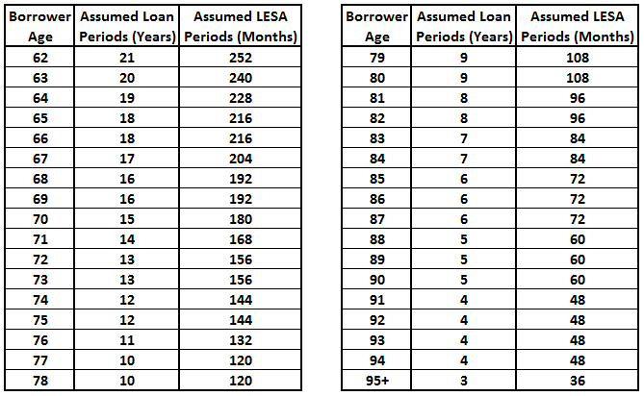
Life Expectancy Tables
From the US Decennial Life Tables for 1979-81
Notes:
We then divide that asset evenly throughout their expected lifetime.
Your LOS will calculate all of this for you, but this slide demonstrates how the monthly period are calculated.
Keep in mind, the table HUD uses is very outdated and does not reflect current life expectancies, but it IS the one we must use. FHA tells us to simply multiply the rounded years by 12 MONTHS.
CLICK
So, an 82-year-old for example has a life expectancy that rounds to 8 years, times 12 equals 96 months.
If this 82-year-old has $96,000 in savings, we could count on income of 96k/96 months or $1,000 per month in dissipated income from that asset.

Slide 98
Credit Guidelines
Liability Type | HECM | SecureEquity®
FICO | N/A | ≤600 - LESA Required ≥720 – Streamlined Financial Assessment (≥660 for co-borrowers)
Property Charges | No lates in last 24 months | 0x30 months 0-24 months 12-month lookback for credit scores ≥ 720 when taxes are current and not using Comp Factors
Mortgages | 0x30 in the last 12 months, 2x30 in months 13-24 | 0x30 in the last 12 months, 2x30 in months 13-24
Installments | No lates last 12 months 2x30 months 13-24 | 12-month lookback. 0x30 lates in last 12 months
Revolving | No major derogatories 3 or more 60-day lates or any 90 day late in the last 12 months | No major derogatories 3 or more 60-day lates or any 90 day late in the last 12 months
Notes:
On SEQ – now coborrower can be at 660
These are guidelines, if they don’t meet – extenuating circumstances

Slide 99
Credit Documents
Credit Report – Tri-Merge or RMCR
Letter of Explanation for any derogatory items on credit report
1009 Addendum - # in household, all relevant income, expense, liabilities and
Homeowners insurance dec page (current and previous year to cover 12 months history from the date of the application)
Tax/insurance payments – 24 months payment history. Gather docs from HOA, title company, third party vendor or tax printouts, copies of bills and cancelled checks that evidences due/delinquent date and paid date covering the last 24 months prior to the initial application date. If taxes are escrowed, include mortgage statements.
Notes:
LOEs for items outside of guidelines, collections, charge offs, BKs
Taxes are escrowed …

Slide 100
Overcoming Credit Issues – Extenuating Circumstances
Death or divorce of a spouse;
Mortgagor’s or spouse’s unemployment, reduced work hours or furloughs, or emergency medical treatment or hospitalization
Emergency property repairs not covered by homeowners or flood insurance
Other causes that directly resulted in late payments of obligations
Notes:
Extenuating circumstances are out of borrower’s control. Not elective surgery, quitting a job, etc.

Slide 101
Validating Extenuating Circumstances
There is a connection between the problem and the measurable impact on the borrower’s finances.
Actions of the client did not contribute to the problem.
The problem is not likely to recur.
The client has access to financial resources that enhance the ability to meet their future financial challenges.
Note: ALL four criteria must be met
Notes:
ALL must be met
Use the HECM in the LOE, what will eliminating a mortgage payment do.
Will they have a LOC to weather emergencies.

Slide 102
When Is A Life Expectancy
Set Aside (LESA) Required?
Required
Credit falls outside of satisfactory guidelines without sufficient extenuating circumstances
  For example: job loss, death, divorce or medical issues, etc.
Although rare, when credit meets guidelines, but residual income is short (and they don’t have sufficient Compensating Factors), a partially-funded would be required.
Not Required
Late payments fall WITHIN HUD’s guidelines of satisfactory credit.
Late payments outside of guidelines WITH sufficient extenuating circumstances and a LOE discussing what caused the late payments and the reasons why the situation is unlikely to happen again.
Hint: Discussing how the HECM will free-up monthly income to ensure financial liquidity can be helpful.
Notes:
A missed payment within guidelines won’t require a LESA.
Are there patterns?
LOEs should include dates – dates that make sense.

Slide 103
What A LESA Includes
Current property taxes (school, city, county, state, etc.)
Taxes due within 60 days of Closing are paid through the loan on all files
Homeowner’s Insurance premiums
Premiums due within 60 days of Closing are paid through the loan on all files
Flood insurance premiums
Premiums due within 60 days of Closing are paid through the loan on all files
LESAs DO NOT include HOA dues
Notes:
NOT HOA dues

Slide 104
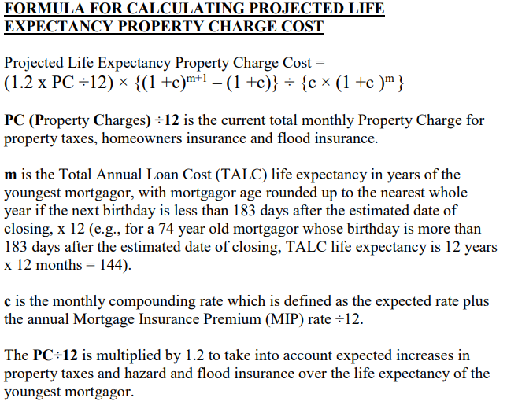
Calculating a LESA
LESA calculations include:
  Life Expectancy of youngest borrower (NBS not counted)
  Current amount of T&I + 20%
  Loan Growth - Expected Interest Rate + Ongoing MIP (0.5%) (HECM only)
Notes:
Loan growth (just like PL) effects LESA
20% accounts for increases in T&I. Escrows are analyzed each year, and T&I payments go up.

Slide 105
LESA Example
Current Property Charges | $6,000 | $6,000
Current Property Charges + 20% | $7,200 | $7,200
LE of Youngest Borrower | 13 years/156 months | 13 years/ 156 months
HECM
Expected Rate + OMIP/12 | 0.552%
Set Aside | $62,985
SecureEquity®
Set Aside | $93,600
WHAT IF
Borrowers need 63K in net HECM proceeds to fund the LESA , what if they don’t?
Lower margins, provide more proceeds.
Discount Origination Fee
Pay down mandatory obligations to free up proceeds.
Bring verified funds to close*
Get a gift*
Revisit Extenuating Circumstances
*Funds cannot be borrowed
Notes:
SEQ has no PL growth, this accounts for the higher set aside.
LESA can be a deal killer if there are not enough proceeds to fund, you can help, they can get a gift or pay down debt.

Slide 106
Selling a LESA
Selling Tool #1 – Eliminates not only principal and interest monthly payment, but also taxes and insurance.
Selling Tool #2 – Greater Piece of Mind!
  No worries about saving for taxes and insurance, knowing where to pay and when their due
  Great sales tool for borrowers who are paying off a mortgage with an escrow account
Selling Tool #3 – Growth (HECMs only)
  Funds in a LESA grow just like the LOC
  Funds only increase loan balance when drawn
Taxes and Insurance may again be the responsibility of the borrowers if funds are exhausted.
Notes:
1. Baby boomers who are coming out of an escrow, may want a LESA.
2. Instead of explaining the reverse will only eliminate P&I, a LESA means your eliminating PI and TI
3. LESA funds MAY run out

Slide 107
Letters of Explanation (LOE/LOX)
Letters of explanation are required for the following:
Any derogatory credit on the credit report
(any credit HUD does not consider satisfactory).
Any delinquent property charge payments within
24 months prior to app.
Any foreclosure or bankruptcy within 36 months
prior to app.
Any collection account or charge off appearing
on the credit report. If disputed, LOE and documentation needed
All credit inquiries within last 90 days
LOE REMINDERS
Should be written in the 1st person
Do not use mortgage jargon or language a borrower would generally not use or understand
Must acknowledge they knew of the account or late payments or include supporting documentation if fraud exists
All LOEs should be written by and/or reviewed by the borrower
Include supporting documentation that ties directly to the LOE
Notes:
Don’t forget the LOEs for credit inquiries in last 90 days

Slide 108
COUNSELING
108

Slide 109
HECM Counseling
All borrowers, non-borrowing spouses, non-borrowing owners and POAs must be counseled as well as beneficiaries of a trust, conservators and guardians.
Counseling must be performed by a HUD approved HECM Counselor.
A list of 5 local counseling agencies and the national agencies that receive grant funds from HUD each year.
Lenders, or third-party originators CANNOT pay for counseling.
That list cannot steer a borrower to any agency.
Counseling should be done prior to application. No services can be ordered, including an FHA Case Number until counseling has been completed.
Some states have additional guidelines regarding counseling. See our Underwriting Guide for state specifics.
SecureEquity®
Proprietary reverse mortgages have similar guidelines to HECMs and must still follow state guidelines.
SEQ allows borrowers to use other proprietary certs including HECM certs.
All borrowers, non-borrowers and POAs must be counseled.
Notes:
Anyone with ownership interest even if you’re not a borrower must be counseled. – HECM and SEQ
Do not create your own list, HUD audits the lists.
Borrower must pay for counseling.
You can order credit, but cannot be charged to borrower, if loan doesn’t close you can’t get reimbursed
Know your state

Slide 110
Who Must Be Counseled
Parties to the Transaction | Counseling Required | Counseling Recommended
Borrowers | ✓
Non-Borrowing Spouses (all) | ✓
Non-Borrowing Owners/ Life Estate Remaindermen | ✓
Non-Borrowing Household Members |  | ✓
Conservators and Guardians | ✓
Power of Attorney (POA) Incompetent Borrower(s) Competent Borrower(s)/signing closing docs only POA signs app AND closing docs (regardless of competency) Competent/Physically incapable | ✓ ✓ ✓ ✓
Trustees and Trust Beneficiaries (that are not eligible borrowers) |  | ✓
Trusted Advisors/Other Family Members |  | ✓
Prohibited From Attending
Reps of lenders or anyone involved in processing
Anyone with financial interest in the transaction.
Notes:
Reps of a lending entity, cannot schedule, attend or in any way participate in counseling

Slide 111
HECM Counseling
The Counseling List | A list of HUD approved counselors must be provided to a potential borrower. HUD updates their list of national intermediaries from time to time. The current list of intermediaries can be found HERE. In addition to those intermediaries, the list must include 5 agencies in the borrower’s home state. States where there are less then 5 agencies may include agencies from neighboring states; at least one agency must be drivable.
 | Recommendation: Use the counseling list that comes from your LOS (QR or RV).
Steering | The list CANNOT steer the borrower to any agency in any way. This includes using a larger or different font, circling, highlighting, listing pricing for counseling sessions or anything else that could be considered steering. Originators may not make the counseling appointment for the borrower. When the counseling is complete, with the borrower’s permission, the counselor may provide a copy of the certificate to the originator.
 | Although originators cannot recommend an agency or counselor, inevitably you are asked, “Who should I call?” What you CAN say…“Call a few agencies, fees and scheduling for counseling can vary.”
Before Counseling | Borrowers often receive “pre-application” packages which include the following documents: (Loan Comparison, TALC, Amortization Schedule, How to Prepare for a Counseling Session, Using Your Home to Stay at Home). Some agencies require that THEY deliver those documents prior to the session being conducted. Prior to counseling, a borrower’s credit report may be run, although if the loan does not close, the borrower cannot be charged. An AVM and preliminary title search may also be ordered prior to counseling, but if the loan does not close, those costs can also not be charged to the borrower.
 | A Counseling Access Code is part of the Proposal Package, so the counselor has access to the same numbers as the borrower.
Notes:
Borrowers must receive 5 documents before counseling.
RV and QR provide Counseling Access Code so that the counselor can use the same numbers as the borrower has.
No steering, no steering, no steering

Slide 112
HECM Counseling
Who Must Be Counseled and When? | The following parties must be counseled: All borrowers, non-borrowing spouses (both eligible and ineligible), and non-borrowing owners Guardians, Conservators or POAs Vested owners at time of application (including children of HECM borrowers coming off title) All vested owners including Remaindermen
 | Recommendation: If in doubt, get them counseled!
Paying for Counseling | Counseling cannot be paid by an originator, broker, or lender. Typically, it is paid at the time of counseling . If the borrower does not have funds, the fee can be paid on the HUD-1 directly to the counseling agency at closing; the counseling certificate MUST indicate that the session was “financed.” Counseling sessions generally cost from $0-$200.
 | Some agencies may offer free or discounted counseling. Originators cannot include prices on the Counseling List, nor can they tell borrowers prices offered by counseling agencies.
Completing the Counseling Session | Counseling is completed via telephone or performed face-to-face Some agencies may have counselors that speak other languages HECM Counseling Certs expire in 180 days; must receive a case number prior to expiration Counseling MUST always be done prior to ordering an FHA Case Number Generally, three copies of the certificate are provided, one to sign and return, one to provide to the lender, and one for the borrower’s records.
Know Your State | Many states have rules around counseling including timing, cooling –off periods, expiration timeframes, and restrictions on counseling waivers for reverse refinances. See our Underwriting Guides for details.
Notes:
More interested parties getting counseled the better

Slide 113
What Is Covered?
Explain the role of counselor
Questionnaire and household budget
Reverse mortgage features
Repayment requirements, borrower obligations, fees, non-recourse, remaining equity, loan limits, impact on public benefits, retention of title, NBS (if app.)
Reverse mortgage costs
Borrower obligations after Closing
Alternatives to a reverse mortgage
Discuss purchasing an annuity
Review understanding, answer questions, discuss next steps
Setting the Appointment
Depending on call volume and availability, sessions are often scheduled within 24-48 hours. When borrower calls to book an appointment, an Intake interview is performed. The following questions are generally asked:
Names of all borrowers, eligible and ineligible NBS and NBOs
Household income and demographics
Estimated home value and existing mortgage
Reason(s) for investigating reverse mortgages
Access Code or LO contact info to get a copy of their loan proposal
Disclose the fee for services and determine if it will be paid up front or financed.
Notes:
Not an ad for RMs, budget review, alternatives.

Slide 114

Which one of the below statements are true about HECM Counseling?
Counseling can be done at anytime during the process
The counseling list cannot steer in any way.
Counseling only talks about the benefits of reverse mortgages
You can pay for the session if you wish.
The counseling list cannot steer in any way.
114

Slide 115
PROPERTY
115

Slide 116
Properties
Reverse mortgages are for primary residences only, generally defined as where the borrower(s) spend most of the year
HECM Eligible Property List
Single Family Residence
2-4 Unit properties
Manufactured Homes
Modular Homes
Planned Unit Developments
Townhomes
Approved Condominiums
Ineligible Properties
Mobile homes
Cooperative units
Commercial properties
Working farms
Investment or 2nd homes
Condo projects less than 2 units
Condos not on approved list
Properties on Native American Land
SEQ Eligible Property List
Single Family Residence
2-4 Unit properties (1 unit owner occupied)
Modular Homes
Planned Unit Developments
Townhomes
Approved Condominiums
Unique Properties with Comps (Berm, Log, Barndominiums, etc.)
Ineligible Properties
Manufactured or Mobile homes
Cooperative units
Commercial properties
Working farms
Investment or 2nd homes
Condos not on approved list
Properties on Native American Land
Notes:
Call out Manufactured and Mobile and SEQ differences.

Slide 117
Lien Seasoning
Non-HECM liens must be in place for 12 months or more (based on HECM closing date).
Liens in place under 12 months can be paid with HECM proceeds provided the borrower received $500 or less in cash (based on the HECM closing date)
HELOC Seasoning – A HELOC must be opened for at least 1 year to be treated as a mandatory obligation.
SecureEquity only requires 12-month lien seasoning on reverse refinances.
Notes:
HELOC is based on Opening, not last draw. No liens seasoning on SEQ except for refis

Slide 118
Condos
HECMs
All condos must be FHA approved
Project – Form 9992
SUA – Form 9991
SecureEquity
In-house - FNMA Limited Review
Agency Approved

Slide 119
Accessory Dwelling Units (ADUs)
A habitable living unit that includes a separate kitchen, sleeping and bathroom facilities, attached or detached from the primary unit, on a single-family lot.
All: Sq Ft of ADU must be subordinate to primary unit.
All: Must be legal and permitted by the town/county.
All: Must be common and customary to the area and have comps.
All: ADU must not jeopardize any future hazard insurance claims.
HECM: A completed HUD-92561 is required
HECM: Rental income from ADU cannot exceed 30% of total monthly income.
All: Only one ADU is permitted.
HECM: The borrower cannot reside in the ADU
SEQ: ADU can be on a single or 2-family property
SEQ: ADU can be a MFD Home
SEQ: Borrower may reside in the ADU but can’t use rental income from primary unit.
Notes:
Blue boxes – HECM, Green, SEQ
ADUs have become more popular. Just heard that NYC is helping homeowners pay for the building of ADUs

Slide 120
Appraisals – AMCs
Appraisal fees or appraisal deposits are often paid outside of closing.
An approved AMC (Appraisal Management Company) should always be used.
Make sure to quote an accurate appraisal fee on your GFE.
HECMs: Appraisals should only be ordered AFTER a case # has been assigned and the Case # must be included on all pages.
Notes:
Maybe one of the fees paid upfront.
10% fee, disclose correctly
Appraisal report must include FHA Case #

Slide 121
Appraisal Forms
All reverse mortgages require a full FHA appraisal.
Uniform Resident Appraisal Report - for all 1-unit single family dwellings, including a PUD (Fannie Mae Form 1004)
Manufactured Home Appraisal Report - for all manufactured homes (Fannie Mae Form 1004C)
Individual Condominium Unit Appraisal Report - for all individual condominium units and site condos (Fannie Mae Form 1073)
Small Residential Income Property Appraisal Report - for all 2-4-unit dwellings (Fannie Mae Form 1025)
Notes:
Pretty much same as forward FHA

Slide 122
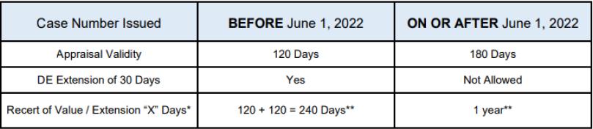
Appraisal Expiration
Appraisals expire 180 days from the effective date of the appraisal report, and the appraisal report must be valid through the disbursement date.
A recertification extends an expiring appraisal for 1 year (30 days for Secure Equity).
**Note: Recertification is not permitted for properties located in a declining market and may not be used to increase value or add comparable sales after the effective date of the appraisal.

Slide 123
What To Watch For…
Case # on report (HECM only)
Lender Name on report
Address matches 1009, FHAC and title report
Borrower is owner of public record
Vacancy or tenants noted
Property offered for sale last 12 months
Property listed as a site Condo
HUD Minimum Property standards
Subject property <1 yr.
Private Well and Septic and distances requirements
Private and Shared Roads
Infestation, Dampness and/or Settlement
Physical Deficiencies and/or Adverse Conditions
Remaining Economic Life
Site Value & Cost New
Peeling/chipped paint on interior or exterior
Legal/Non-Conforming Use
Required Repairs- safety, structural and sanitary
Repair set-asides for cosmetic repairs
Manufactured Homes and Leaseholds must meet HUD guidelines.
Notes:
Case number for HECM, no case number on EE or other proprietary.
Borrower Owner of record – Owner name should be on page 1 of the appraisal, if not the appraiser is supposed to let us know and why. If recently purchased maybe the local municipality hasn’t updated their records.

Slide 124
Second Appraisals
HECMs
After the first appraisal report is logged into FHAC, a second appraisal MAY BE required.
HUD’s Collateral Risk Assessment (CRA) guidelines randomly selects loans for a second appraisal.
When a second appraisal is required a different appraisal company must be used (same AMC is allowed).
The lower of the two values must be used.
SecureEquity®
Second appraisals are required for properties over $2,000,000, lower value is used.
Borrowers can waive 2nd appraisal if agrees to use PL based on the >$2 million value.
Notes:
Discuss CRA – will not know if HUD will require 2nd until 1st is logged. We don’t know the algorithm.
SEQ, borrower doesn’t want to spend more $ on 2nd appraisal or fear it may come in less, they can opt out.

Slide 125
Repairs
Property deficiencies are identified by an appraiser, inspector, or termite company.
The underwriter decides which of these problems must be repaired.
Repairs determined to present immediate health and safety risks to the occupant(s), or the structural integrity of the home will be required to be completed prior to closing.
Repairs determined to be more cosmetic in nature will be allowed to be completed after closing and as a repair set-aside will be collected.
Appraiser cost-to-cure is typically acceptable for simple/cosmetic repairs.
More extensive repairs or repairs that require a bid from a professional in a specific field will require a licensed contractor bid.
The repair set-aside amount will be calculated at 1.5% of the amount shown on the bid.
Note: Contractor bids must show license number, company name and be signed.
Notes:
Repairs are same for HECM and SEQ.
Deferred maintenance?
Repairs prior to vs set aside

Slide 126
Repairs Prior To Closing
Examples of repairs required prior to closing include but are not limited to:
Inadequate exits from bedrooms to the exterior of the house.
Actively leaking roofs or worn-out roofs that could cause a safety issue.
Evidence of structural problems, such as foundation damage caused by excessive settlement.
Defective paint surfaces on exterior/interior of homes, pre-1978 where children reside in the property.
Defective exterior paint surfaces on any home, regardless of the age of the home, where the finish is otherwise unprotected (exposed wood).
Broken or inoperable windows.
Missing Handrails/Railings (interior or exterior) – causing a safety hazard.
Missing fire rated door between garage and home.
Earth to wood contact.
Infestations of any kind.
Well and septic not meeting distance requirements.
Exposed/damaged wiring.
Any problem noted in the appraisal as a “health or safety” issue.
Notes:
Even these could be a set aside if minor

Slide 127
Repair Set-Asides
A set aside is established at 150% of the repair estimate provided by the appraiser or contractor. The minimum repair set-aside amount is $500.00, if less than $500.00 repairs to completed prior to closing.
Repairs more than 15% of MCA must be completed prior to Closing. Some repairs can be completed to get repairs below the 15% threshold.
Repairs must be completed within 6 months of closing. (extensions MAY BE available but must be requested PRIOR to the expiration on the Repair Rider). Repairs not made prior to expiration (including extensions), may freeze access to LOC and/or monthly payments.
Once complete and inspected, the funds are disbursed, and the lender verifies that all liens are removed. If repairs funds remain, those funds will be available in the LOC (ARMs only).
There is a Repair Admin Fee of 1.5% (min/max. $50/$250) of the repair amount.
Repair Set Asides are not allowed on purchase loans.
Notes:
Same rules for both

Slide 128
Life Estates
Traditional:
The remainderman interest is effective immediately and they are on title.
The remainderman must complete counseling, and execute the following at closing:
  Deed of Trust and any riders
  Recission and Truth in Lending
Ladybird or Testamentary:
Where the remainderman interest is effective at the death of the owner.
Title to provide an explanation as to why the remainderman are not listed on vesting even though the deed shows the life estate.
Where the “death deed” is confirmed from title/attorney, and where the remainderman has no other role in the file, the remaindermen is not required to be counseled.
A Lady Bird Deed is only allowed in the following states: FL, MI, TX, VT, WV
Notes:
Bullet 5-Encourage them to be counseled
Borrower had rights to live in house until death or title changes.

Slide 129
Trust Eligibility
Eligibility:
The Borrowers must be the primary beneficiaries of the trust. They cannot be the residual, contingent, or alternate beneficiaries.
A complete copy of the Trust must be submitted to the underwriter and the title company with all amendments and schedules.
Review and approval of the trust by a qualified attorney AND title company is required.
An attorney’s opinion letter must be submitted to or obtained prior to the loan being approved for final closing documents and/or purchase
Signing:
The trustee(s) must sign the following at closing: Note, Security Instrument and Riders, Right to Cancel and TIL. The Trustee does not execute the Loan Agreement.
Borrowers must sign the Note, Security Instrument and all other loan documents. If the borrower(s) and the trustees(s) are the same, they must execute the mortgage deeds as both Trustee and Borrower).
The Trust Acknowledgment must be executed at Closing for all loans closing in a Trust.
Notes:
Lender must …-Send it to lawyer
Full title… No partial ownerships
Encumber-saddle (a person or estate) with a debt or mortgage.

Slide 130
AGENDA – PART IV
After Closing
130

Slide 131
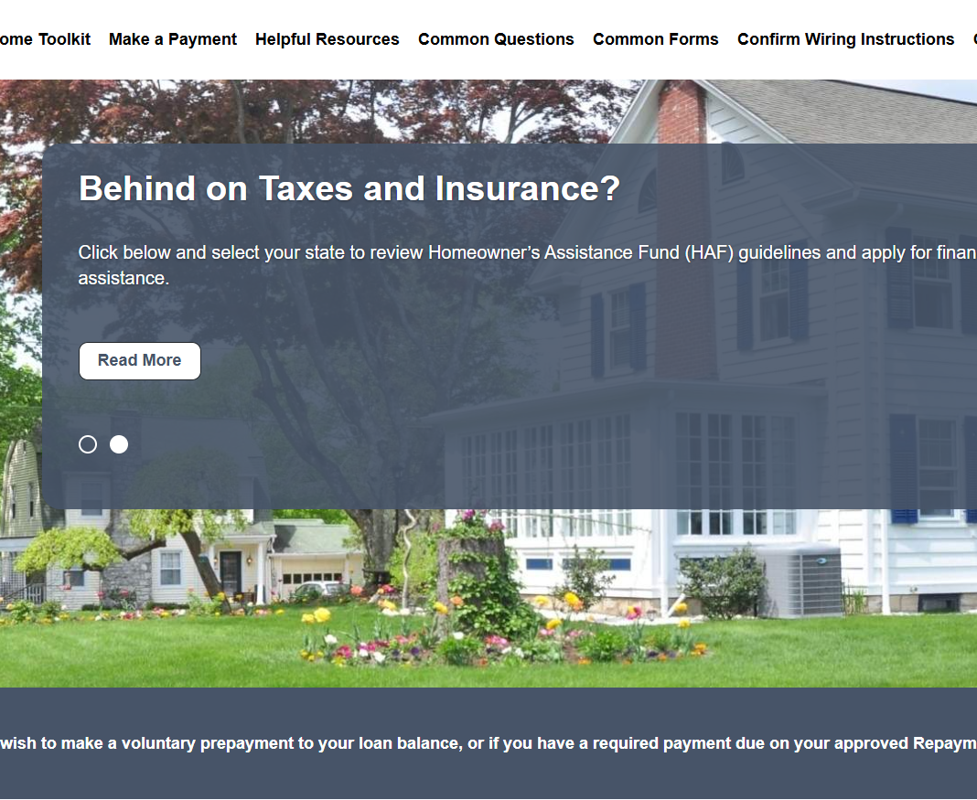
Loan Servicing
Monthly Statements – All loans receive a monthly statement.
Payments – Monthly payments, LOC draws and/or payment plan changes. LESA payments made directly to insurance company and taxing authority.
Occupancy Certifications – Borrowers
must certify their occupancy annually.
Defaults Events – Works with borrowers
when T&I isn’t paid or repairs have not
been made.
Due and Payable – Works with borrowers or heirs when D&P event occurs.
Check out www.reversedepartment.com
Notes:
Servicers play maybe the MOST important part of the process. They are the team that answers all your clients’ questions during the life of the loan, deals with the estate, etc…

Slide 132
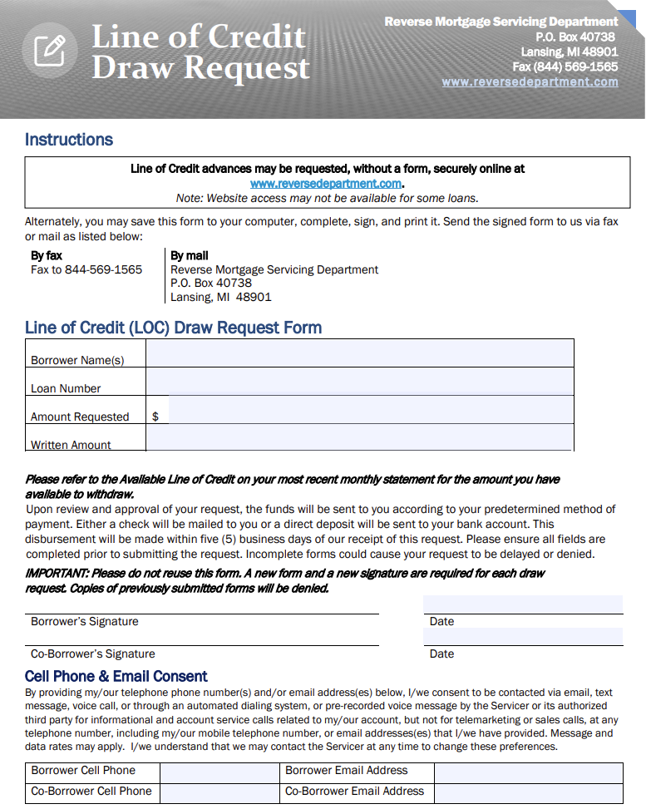
Line-of-Credit Advances
Must complete LOC Draw Form or use Borrower Portal. Requests cannot be made over the phone.
Funds disbursed via Direct Deposit (preferred) or check mailed USPS within 5 business days from receipt.
Checkbooks or debit cards are not allowed.
LOC advances are subject to Initial Disbursement Limit (IDL) restrictions.
LOC funds are not available when loan is in default or when D&P has been deferred (eligible NBS).
Attorney-in-Fact: must sign “POA Name, Attorney-in-Fact for <Borrower Name>.”
Unused LOC funds are not available after the last borrower’s death.
Notes:
No checkbooks or debit cards

Slide 133
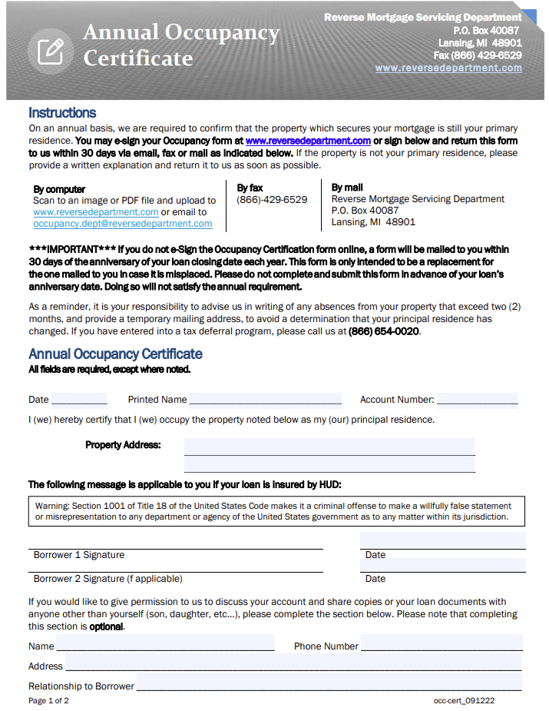
Occupancy Certificate
Complete annually - near the loan closing anniversary
Can be completed on portal or by calling the Servicer (ML 2023-23).
Complete and return within 30 days. If not:
    2nd Notice
    Phone Call
    Alternate Contact
    In-person visit
Continues to be required for NBS during deferral period
Notes:
EVERY YEAR – not returned – can be a default event.

Slide 134
Loan Maturity
Event | Notification | Payoff Required or Remedy | Timeframe
Borrower(s) sells the home (If the borrower occupies the property until sold, the loan is not due and payable) | Borrower notifies the Servicer | Lesser of loan balance or 100% of appraised value. Maintains ability to sell the property, whether HECM is D&P (lesser of outstanding balance or appraised value). See ML 2014-07. | N/A
Last borrower passes away or hasn’t occupied home for 12 mos. for medical reasons | Heirs or estate notify Servicer; receives notice from SSA or HUD. | Sell or payoff (finance) property for the lesser of loan balance or 95% of appraised value. | 6 mos. from the date of death, if required docs are provided within 90 days from DOD*
Last borrower no longer occupies the property as their primary residence. | Borrower notifies Servicer or indicated on annual Occupancy Certification. | Sell or payoff (finance) property for the lesser of loan balance or 95% of appraised value. | 6 mos. from date HUD approves D&P if required docs are provided within 90 days from D&P.*
Tax or insurance default | Notification from insurer or municipality | Loss mitigation options including payment plans (see Mortgagee Letter 2015-11 and 26 2016-01) | See Mortgage Letter 2015-26*
Non-completed repairs default | From the Servicer | This is not applicable to repair default. LOC and monthly payments are suspended; LESA funds will continue to be disbursed. | N/A
Notes:
95% is for D&P events, not all maturity events!
Don’t tell your borrower or the kids they have a year.

Slide 135
Default/Maturity Events Resolution
DEFAULT | Last or all borrowers move out of subject property
RESOLUTION | At least one borrower returns to home and certifies occupancy
DEFAULT | Failure to maintain condition/condemnation
RESOLUTION | Repair or Sell property, execute a Deed-in-Lieu of Foreclosure
DEFAULT | Title Transfer - no borrower remains on title
RESOLUTION | Return at least one borrower to title (if trust, contact servicer for approval)
DEFAULT | Death - of last remaining borrower or non-borrowing spouse
RESOLUTION | Payoff Loan Short Sale – if in default, sell for 95% of market value; if not sell for 100% Deed-in-Lieu – title must be clear and property broom-swept

Slide 136
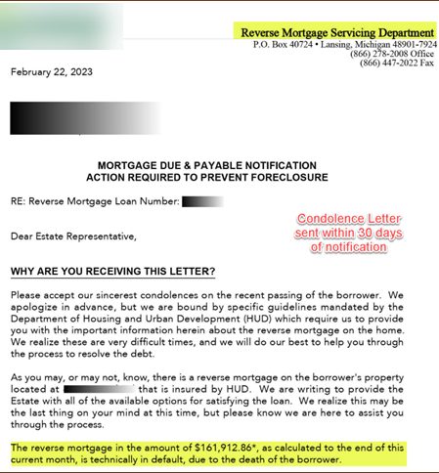
Loan Maturity
When the last surviving borrower no longer lives in the home for most of the year, sells the home, or conveys title to someone else the loan is due and payable (maturity event).
Since the loan is a non-recourse loan, the home is the only source of repayment.
When the loan is due and payable, the debt can be satisfied for 95% of the current appraised value, less customary closing costs or current outstanding balance if less.
Demand Letter (aka Condolence Letter) sent upon notification
  HUD language; 30 days to satisfy debt or provide letter of intent.
Notes:
Give the heirs all the options!

Slide 137
AGENDA – PART V
Selling Reverses
137

Slide 138
Good to Know
It’s still a mortgage, but it’s a different sale.
May take several calls or visits before decision-making
Get decision makers involved early
Decision is often emotional
First Contact
Introduction
Name, Company, NMLS
Information Gathering
Goals-based – What are you trying to accomplish?
Knowledge of the product – What have you heard about reverse mortgages?
Wrap-Up
Affirm their goals, normalize the product, assume the sale (when, not if).
Next steps, be specific (date and time)
Where did you hear that from?
Notes:
These are longer sales…not first-time buyers. Your mailers may get you a call quickly or it may take a year or 2!

Slide 139
Involve The Client
Clients want information, provide brief definition of a reverse mortgage
Have client write down 5 quick product features:
No monthly mortgage payment required | Proceeds available tax-free | Spousal protection (HECM) | You remain on title (no one is added) | Heirs do not have to pay back more than the home is worth
Notes:
Involve the kids or trusted advisors too.

Slide 140




Uncover True Goals
Home
Lifestyle
Family
Finances
Notes:
Maybe a combination

Slide 141
Property Questions
What type of home is it?
How long have you lived there?
How long do plan to stay in the home?
On a scale of 1 – 10 how would you rate your home?
If I gave you $10k to fix up your home, how would you use it?
Who is on title?
Home
Notes:
This will enable to start the process.
Repairs?
Possible Equity
Do you owe the home alone?

Slide 142
Family Questions
How many kids do you have?
Do you have any grandkids?
Where are they located? (Identify additional decision makers)
How often do you see them?
Would you like to see them more?
If you got into a bind, which family member would you go to first?*
Tread lightly, as this could open a can of worms!
Family
Notes:
Identify the trusted advisors and also who might be a concern – who you may need to educate/win over.

Slide 143
Lifestyle and Future Planning
Are you working or retired?
If working: Are you working out of need or want?*
How long have you been retired?
Did you have to make any cutbacks when you retired?
*Potential landmine
Lifestyle
Notes:
Need or Want?

Slide 144

Financial Worksheet
I want to go through an exercise that clients have appreciated once we were done. Please grab that sheet of paper and turn it over…
Please draw a line down the middle of the page. Next, I need you to draw a line across the top of the page making a big T. On the right-hand side please write Expenses. On the left-hand side please write Income.
Income
Expense
Finances
Notes:
You will develop your own style, but many use something similar to illustrate how a reverse can help them.

Slide 145
Income Questions
Employment | Are you still working? (If yes) Can you get your pay stubs for the last 30 days (most recent) and a copy of last year’s W-2? (If self employed)
Tax Returns | Can you get your personal and business tax returns for the last two years? Do you plan to continue working for 3 years?
Social Security | Are you collecting social security? (If yes) How much do you get? Do you have your awards letter? (Optimal documentation)
Pension/Other Income | Do you have any pensions or other sources of regular income?
Savings | Do you have any savings accounts, IRA’s or 401(k)’s etc.? (If yes) How much do you have? How often do you need to tap into them?
Notes:
Are you still working? (If yes) Can you get your pay stubs for the last 30 days (most recent) and a copy of last year’s W-2? Those documents will help get the file through. Here were asking for only 30 days. Underwriting will ultimately ask for 60 days, but if we can get their last 30-day statement, as we move the file forward UW is going to ask for the most current 30 days and that will give us 60 days. This is an example of not making the borrower jump through unnecessary hoops. We are going to ask for the most current 30 days during underwriting, so why make them dig up old statements that aren’t ultimately going to be used.
Can you get your personal and business tax returns for the last two years? So here if our borrower is self employed we’re going to need this. And we’re going to need both personal and business. Now, for the income to count, one of HUD’s rules is it has to be reasonably expected to continue for the next 3 years. If they aren’t going to work for the next 3 years, technically, that income will not count.
Are you collecting social security? Of course, Social Security is one of the most common forms of income we see. Now, whether you start by asking about Social Security first and work income next is really up to you. But you will want to ask about both.
How much do you get? Do you have your awards letter? So, if they are getting SS we also want to know if they have their awards letter. As we’ll see, we can use bank statements to verify SS but we can only use the actual amount of the bank statement. As an example, let’s say they are having their Medicare premium taken out then the amount being deposited will only be what is left. Right off the top they aren’t getting the true income amount that they could, so getting the award letter is definitely in their best interest. Sometimes these files come down to just a small amount being the difference in a being required or not. So every time we can use the bigger number, that is always better.
Do you have any pensions or other sources of regular income? According to the guidance from HUD, a government pension, such as a state retirement account, is for the borrower’s life. We no longer have to get the awards letter to prove the pension will last more than 3 years. Now, to be clear, that only applies to government pensions, private pensions we still need to have an award letter that shows the retirement is for life. Additionally, when we talk about Regular Income, this is anything that will continue for the next 3 years. If the borrower has an annuity or something like that, that can work as well.
Do you have any savings accounts, IRA’s or 401(k)’s etc.? (If yes) How much do you have? How often do you need to tap into them? The key here is the last question: How often do you need to tap into them? Often a borrower will say they have enough money. But, when asked this question it reveals their true need. If they say they are tapping into $300-$400 a month, we discover that they don’t really have enough money. So when we ask how much they have, we are looking for a resource for the asset dissipation that may be required to meet the residual income requirement. As an example: a borrower might not have a tradition retirement account, but does have a 401k and is drawing from that. We can use that fund if needed to dissipate to support needed residual income.

Slide 146
Income
You mentioned you were both retired, are you collecting Social Security? How much do you receive each month?
  Mine is $800 and my husband is $1,200
  “Please write that down under the income side of the page.”
Are there any other sources of income?
  Yes, we have a pension of $650 per month
  “Write down total and circle it.”
Income
Expense
$1200 – SS
$800 – SS
$650 – Pen
$2,650
Notes:
Other sources of income. This might be a good time to ask about .

Slide 147
Expense Questions
Taxes and Insurance | What is your annual property tax & homeowner’s insurance?
Utilities and Maintenance | How big is your home? (above grade square feet)
Installments | Do you have a car payment? If yes, what is the monthly payment? (use minimum due if they are paying more) How many more payments until it is paid off? (If 10 or less, can be excluded)
Revolving Debt | Do you have any credit card debt? If yes, how much do you owe and what is the monthly payment? (use minimum payment due if they are paying more)
Other Property Charges | Do you have any HOA, Condo or PUD dues?
Other Debt | Do you have any other debt we haven’t talked about yet? (looking for installment debt with 10 or more monthly payments left)
Notes:
At the initial call you should suggest having the client gather expense and income docs.

Slide 148
Expenses
You mentioned that your mortgage was about $85k. What’s your monthly payment? Does that include taxes and insurance?
  $900, no that’s another $350 a month
  “Please write down $900 under Expense and P&I next to it, under that write down $350 and T&I.”
How about credit cards and installment loans, like car loans or leases?
  Credit cards are about $250, and we have a car loan of $400.
  “Write down the total minimum payments and the balance”
How much do you spend each month on groceries?
  About $100 a week
  “Write that amount down too.”
Income
Expense
$1200 – SS
$800 – SS
$650 – Pen
$2,650
$900 – P&I
$350 – T&I
$250 CC ($8K)
$400 Car ($18K)
$400 Food

Slide 149
Expense Total
We talked about your monthly income being $2650. Would you say that your expenses are more than that, less than that or the same? By how much?
  About the same.
  “Please write down XXXX and circle it.”
Income
Expense
$1200 – SS
$800 – SS
$650 – Pen
$2,650
$900 – P&I
$350 – T&I
$250 CC ($8K)
$400 Car ($18k)
$400 Food
$2,650
Notes:
About the same

Slide 150
Savings
How much do you have in savings (can be savings account, 401(k), IRA, etc.).
  We only have about $5,000 in savings and checking and a CD for $10,000
  “Please write that down below the income section of the page.”
How much was in that account two years ago?
Income
Expense
$1200 – SS
$800 – SS
$650 – Pen
$2,650
$5,000 – Sav
$10,000 - CD
$900 – P&I
$350 – T&I
$250 CC ($8K)
$400 Car ($18k)
$400 Food
$2,650

Slide 151
Be A Detective
Compare income, expense and savings amount to see if everything lines up.
If income and expense match, find out how/why savings went down.
If they are short every month, how are they making up shortfall?
If they have excess income, does savings account show it?
Income
Expense
$1200 – SS
$800 – SS
$650 – Pen
$2,650
$5,000 – Sav
$10,000 - CD
$900 – P&I
$350 – T&I
$250 CC ($8K)
$400 Car ($18k)
$400 Food
$2,650

Slide 152
Call Wrap-up and Scheduling Follow-up
Let them absorb what you have already discussed.
Review all goals borrower has shared
Intro, quadrants, financial worksheet
Can I answer any questions now?
Based on what your goals it sounds like a reverse mortgage maybe a perfect solution. Do you agree?
Don’t overwhelm
Check for understanding
Get agreement
Notes:
Don’t try to do EVERYTHING on a single call.

Slide 153
Agreement Options
Yes
Great, I need some time to put together a couple of programs for you, will you be available at 3 p.m. today?
If no, what time works best for you?
No or Unsure
I apologize, maybe I missed something. My previous borrowers who have felt this way have either not understood something or not liked something about the program. Which one are you?
Notes:
Don’t push, if they are unsure, ask about talking to family

Slide 154
Next Call
Review all goals the borrower has shared (intro, quadrants, financial worksheet)
Since we last spoke have you thought of anything additional you would like to accomplish?
If yes: That is a great idea, where would you put that in relation to your other goals? What else would you like to accomplish?
Notes:
Call 2. Review what you talked about last time.
Have you thought of anything new? Accomplishments, questions.
Have you talked to your kids or others? Did they have questions?

Slide 155
Satisfactory Credit
Mortgage | Have you paid your mortgage on time for the last 2 years?
HOI | Have you had homeowner’s insurance for the last 12 months? Did you pay it on time?
Escrow Account | If T&I paid via Escrow, can you provide copies of your mortgage statements for the last 2 years?
No Escrow Account | Have they been paid on time for the last 2 years?
Credit Report | Do I have your authorization to run your credit?
Based on this discussion and credit report, is a LESA a possibility?
Notes:
These are the questions we need to ask:
Have you paid your mortgage on time for the last 2 years? This is an easy way to start. A nice, kind of soft question that should be relatively easy to answer and one that helps people understand where we’re coming from and what they are going to need to have. If they answer yes. Great, we can check this off the list. It also allows us to move deeper now.
Have you had homeowner’s insurance to the past 12 months? And, did you pay it on time? We need to make sure that they did have insurance for the past 12 months, and that the policy was paid on time.
The next question: Are your property taxes and homeowner’s insurance paid through an escrow account or do you pay them directly? This is an important question, and their answer is going to drive follow up questions. If it was through Escrow, great, we know the insurance is being paid and this won’t be an issue. Now we can change our focus to payment of the mortgage on time. If it is paid directly, they HUD is willing to give them little bit of benefit of the doubt, as long as they’ve been paying them on time. By paying them on time they will get a little bit of leeway when we get to their Residual Income. But with the Escrow we know for sure that they’ve been paid and the documentation for that is significantly less.
If they have been paying directly, have they been paid on time for the last 2 years?
If escrowed, can you provide copies of your mortgage statements for one month? With escrow we only need the last month’s statement to verify the taxes and insurance are being paid.
The final question here is: Do I have your authorization to pull your credit? This question doesn’t have to specifically be asked here. You’ll find that all the questions don’t have to be asked in any specific order, but they will all need to be asked and you’ll need to be sure you’ve generated the needed trust before asking your borrower.

Slide 156
Update the Worksheet
Ask the borrower to grab the financial worksheet from the last call.
  “Cross out the $900 P&I and write $0 next to it”
  “Next, cross out the $350 and write 0 next to it”
  “Now do the same thing with the $8k credit card balance”
Now we are going to do the same thing with your car payment.
  “Cross out the monthly payment and total”
Income
Expense
$900 – P&I $0
$350 – T&I
$0
$250 CC ($8K)
$400 Car ($18k)
$400 Food
$2,650
$1200 – SS
$800 – SS
$650 – Pen
$2,650
$5,000 – Sav
$10,000 - CD
Notes:
Let’s talk about getting rid of some expenses. We will pay off your mortgage, but you can take cash out when the loan closes to pay off the car and credit cards to free up even more of your monthly income

Slide 157
Update the Worksheet
The next thing we need to do is update your total expenses for the month.
By eliminating your monthly mortgage, credit card and car payments you are reducing your expenses by $1,550 every single month.
  “I want you to cross off the $2,650 in the expense category and write $1,100 below that.”
$1,100 is your new expenses. How would it feel to still have $2,650 of income but only $1,100 expenses?
Income
Expense
$1200 – SS
$800 – SS
$650 – Pen
$2,650
$5,000 – Sav
$10,000 - CD
$900 – P&I $0
$350 – T&I
$0
$250 CC ($8K)
$400 Car ($18k)
$400 Food
$2,650
$1,100
Notes:
With foods prices going through the roof, that $400 is likely to increase.

Slide 158
Update the Worksheet
The good news is that we are not done yet.
In addition to paying off these bills freeing up additional income every month you will have access to a line of credit of $119,508
This is equity that you can use for whatever you want. You mentioned that being prepared for life’s curveballs is important,
  “So, what I want you to do is above the $5,000 you have for savings, write $119,508 and LOC next to it.”
Income
Expense
$1200 – SS
$800 – SS
$650 – Pen
$2,650
$119,508 LOC
$5,000 – Sav
$10,000 - CD
$900 – P&I $0
$350 – T&I
$250 CC ($8K)
$400 Car ($18k)
$400 Food
$2,650
$1,100
Notes:
What happens when you need a new car? Have a financial emergency, want to update the house? Explain the LC

Slide 159
Time For Numbers – Option 1
I want to give you the details about the program,
  Grab a new sheet of paper and make a big T on it like we did before.
On the left-hand side at the top, write HECM ARM. This is the first product I want to review with you.
Below the line I want you to write down 6.25%. That is the current interest rate for this loan.
Below that I want you to write down $225,000. At your age and assuming your home appraises for what you expect, this is the maximum I could lend you on day 1.
HECM ARM
6.25% - Interest
$225,000
Max loan amount
Notes:
Loan Info: 9/30/26
CREV Selling Example
10868920
70 Y/O, MCA $600,000
Now let’s talk reverse options… first we’ll start with the HECM, the government insured reverse

Slide 160
Time For Numbers – Fees
The next thing I want you to do is write down these three numbers:
  $6,000, $12,000 and $2,475
The $6,000 is the loan origination fee.
  I want you to write OF next to it. That is the fee that my company is paid. That pays for me, your processor and the entire team dedicated getting this loan done for you.
The second number is the Mortgage Insurance Premium, that’s what FHA charges for the loan. MIP protects you and your heirs from ever having to pay back more than what your home is worth. It also protects you in case the lender becomes insolvent. FHA will guarantee any remaining line of credit you have.
The third number are the 3rd party closing costs. This is for things like your appraisal, title insurance etc. These are basically the same fees you would have seen when you got your existing mortgage.
HECM ARM
6.25% - Interest
$225,000
Max loan amount
$6,000 OF
$12,000 MIP
$2,475 3rd Party Fees
Notes:
These are the fees, government insurance comes at a cost, but it also provide protection, for you, your family and us.

Slide 161
More Numbers – LOC
The next number I want you to write down is $20,475, that is the total of all the fees we talked about.
The good news is that you do not have to come out of pocket for all the fees. Typically, my clients only pay the appraisal and HUD counseling. Everything else can be part of the loan.
The other good news is that I already took that into account when I gave you the safety net number earlier.
Below the total, I want you to write down $119,508. That is the total line of credit you will have after paying off your mortgage and the fees. Next to the number write down LOC.
HECM ARM
6.25% - Interest
$225,000
Max loan amount
$2,000 OF
$10,000 MIP
$2,475 3rd Party Fees
$20,475 Total
$119,508 LOC
Notes:
If you decided to take cashout to pay off car and CC, the LOC would be less, but still over $80k

Slide 162
TIME FOR NUMBERS – OPTION 2
Now I want to move to the other side of the sheet. At the top, please write down SEQ+. Below the line, please write down 9.5% and put INT next to it. The reason it is the same as the top number is because this is a fixed product, so the interest rate won’t change.
Below that please write down $271,800 and put max loan amount next to it. This is the maximum I am allowed to lend you on this product.
Below that I want you to write down the same fees, $10,872, $2,811 and $13,683 total.
Below that, I want you to write down $173,117. This is the cash you would receive after the loan closes, since this is a fixed rate loan there is no line of credit, you get all the loan proceeds upfront.
HECM ARM
SEQ +
6.25% - Interest
$225,000
Max loan amount
$6,000 OF
$12,000 MIP
$2,475 3rd Party Fees
$18,475
Total
$119,508 LOC
9.5% - Interest
$271,800
Max loan amount
$10,872 OF
$2,811 3rd Party Fees
$13,683 Total
$173,117 Cash
Notes:
The other option is a private reverse, not government insure, but with many of the same protections. Rates are higher, but loan amounts are higher and fees are generally lower.

Slide 163
Time for Numbers
These are the two programs that I came up with based on what you were trying to accomplish.
Looking at the two options, which one do you prefer?
That is exactly the one I would have picked for you too. Why do you like that product?
Do me a favor, put a big circle around that one.
HECM ARM
SEQ +
6.25% - Interest
$225,000
Max loan amount
$6,000 OF
$12,000 MIP
$2,475 3rd Party Fees
$18,475
Total
$119,508 LOC
8.99% - Interest
$248,500
Max loan amount
$9.940 OF
$2,681 3rd Party Fees
$12,621 Total
$150,469 Cash
Notes:
Which one looks better to you?
What questions do to have.

Slide 164

True or False, if a borrower does not currently have Homeowner’s Insurance, they are not eligible for a reverse mortgage?
False – they will have to purchase a policy and the premium for the first year maybe paid from loan proceeds.
164

Slide 165
AGENDA – PART VI
Loan Flow
165

Slide 166
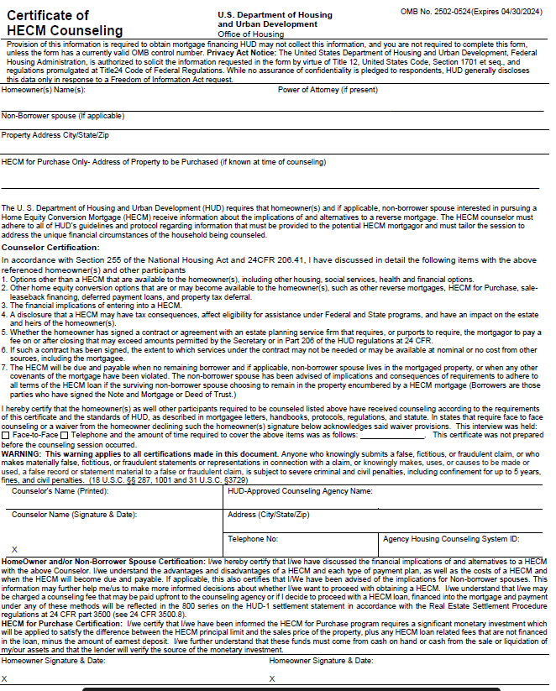
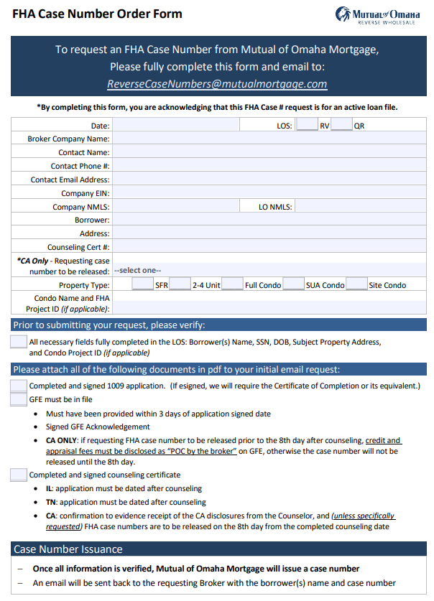

The Wholesale Loan Process
Services
Credit Report (can be ordered earlier) Appraisal
Title
Flood
LDP/SAM
USPS
PARTNER
Proposal (LOS)
Application (LOS)
Loan File
Generally provided after a few initial calls/ conversations
Required parties should be counseled prior to application, required in some states
Application taken
E-Sign, Face to Face, Telephone
(HECM only)
Only Lenders can order FHA Case Numbers
Services* cannot be ordered prior to Case Number
*Credit and Prelim Title can be ordered earlier
After services come back, upload all loan docs and submit file.
Notes:
Before the Loan process can begin, the loan application package is required to be completed, the Borrower must complete HECM counseling and provide the signed/dated Certificate of Counseling, and the appraisal inspection is completed. The loan file can be submitted to Liberty once all three of these items are completed.
When the Broker submits the loan file to Liberty, the loan file moves through phases in the process, which starts with File Intake then ends with both Insuring and sale of the loan.
Let’s take a look at what happens during the File Intake phase.

Slide 167
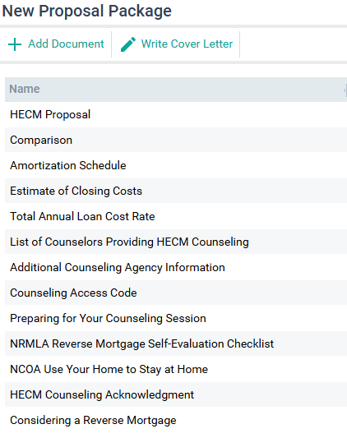
Proposal
Usually provided to customers who are planning to move forward after multiple contacts.
Includes HUD/Lender Compliant Counseling List.
(HECM only) Includes documents that are required to be disclosed before counseling.
Does not require signatures.
Notes:
Most borrowers receive a proposal package prior to application. Doesn’t need to be signed, except in NY.

Slide 168
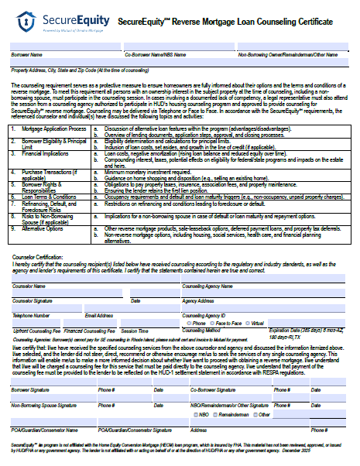
Counseling
HECM
Can be done before or after application (in most states) but MUST BE DONE before FHA Case Number Assignment
Completed Cert must be submitted with Case Assignment Request
Can be E-signed
SecureEquity®
Counseling certificate required before loan submission.
Other certs are allowed (except when NBS remaining on Title)
Can be E-signed

Slide 169
DISCLOSING REVERSES
169

Slide 170

Disclosing Basics
Reverse mortgages are not subject to TRID, a GFE and HUD-1 are used for all reverse transactions. The GFE is part of the application package but must be disclosed within three business days of application.
GFEs include the estimated costs associated with the loan, all fees disclosed are subject to tolerance levels and can only be redisclosed for a valid reason, known as a Valid Change Circumstance (VCC).
When allowable fees change, they must be redisclosed within three business days.
Notes:
No TRID, we use GFEs, HUD1s and are governed by RESPA.
GFEs are part or the app package, but you have 3 business days to provide.
Fees cannot change without a VCC and only if they are disclosed within 3 days.

Slide 171




Reasons For Redisclosure
Product Changes: ARM to Fixed or Fixed to ARM
Title Changes: Adding or removing parties from Title, placing property in or out of Trust, etc.
Product Changes: property type different from what was disclosed
Inspection Fees: Items noted in the appraisal may cause inspections (structural, infestation, etc.)
Value Changes: Fees that are based on value and/or loan amount
Notes:
Fees cannot change without a VCC and only if they are disclosed within 3 days.
Only fees related to the change can be redisclosed. In other words, if we find out we had the borrower’s incorrect birthday, we can’t redisclose the appraisal fee.

Slide 172
Redisclosing Step-by-Step
Loan Not Submitted:
Update system data
Verify and update Fees
Print redisclosure package
  Within 3 business days of change
Include redisclosures with loan submission
Loan Submitted:
Provide updated information to Mutual as soon as known.
Mutual will update system data and verify and update fees.
Mutual will print redisclosure package for broker to deliver to borrower
  Must be delivered within 3 business days of change.
Notes:
You have the file, you redisclose, we have the file, let us know and we will redisclose or open the file back to you.

Slide 173
If the appraisal notes visible infestation and the Underwriter calls for a pest inspection how many days do you have to redisclose the fee?
Within 3 days of the loan condition.
173

Slide 174
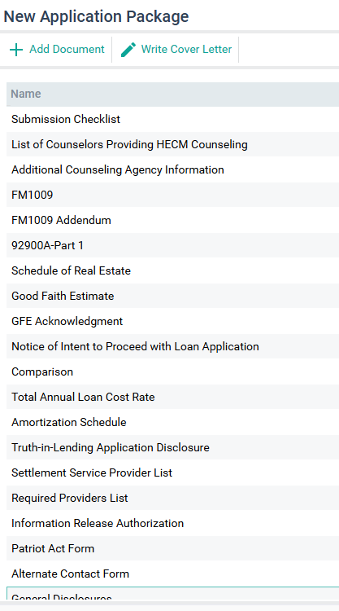
Application
Print ALL pages of the package, including GFE.
Application can be E-Signed. Email address must belong to the borrower.
E-Signed packages must contain Submission Certification.
Notes:
E-signed must go to BORROWER email address

Slide 175
Request FHA Case # (HECM only)
No services that will incur costs to the borrower can be ordered prior to FHA Case Number Assignment
Exception: Credit Report, Preliminary Title
A Completed Counseling Certificate must be submitted along with a signed GFE and 1009 and the Order Form.
Notes:
Only lenders can get case numbers

Slide 176
Order Loan Services
Credit Report - May be ordered before application (but can’t be charged if loan doesn’t close)
Appraisal – Use approved AMC. Case Number must be listed on Appraisal Report.
Title – Preliminary title can be ordered earlier. Title will verify vesting, liens, taxes and legal description.
SAM/GSA – Checks all parties are not excluded from participating in federal contracts or federal financial or nonfinancial transactions.
USPS – Verifies the subject property has a physical address.
Services
Credit Report
Appraisal
Title
Flood
SAM/GSA
USPS
Notes:
Brokers order

Slide 177
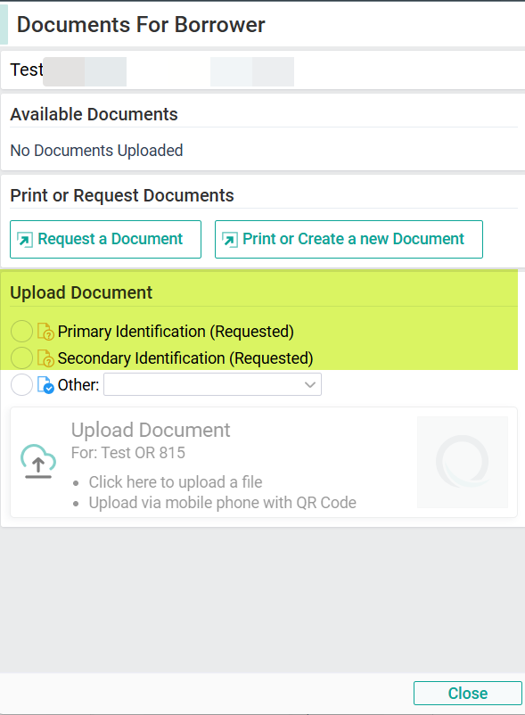
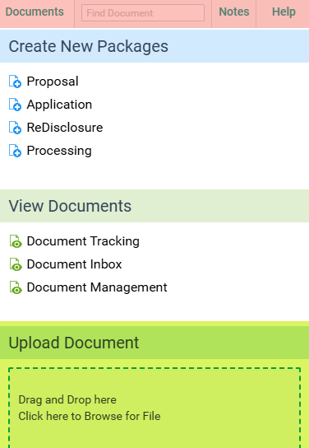
Loan Submission
Upload Documents
Notes:
When services come back….

Slide 178
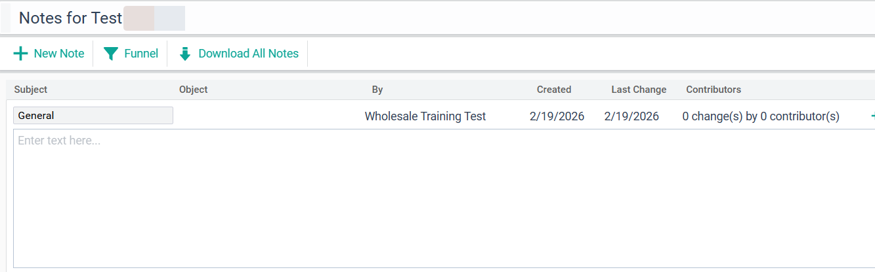
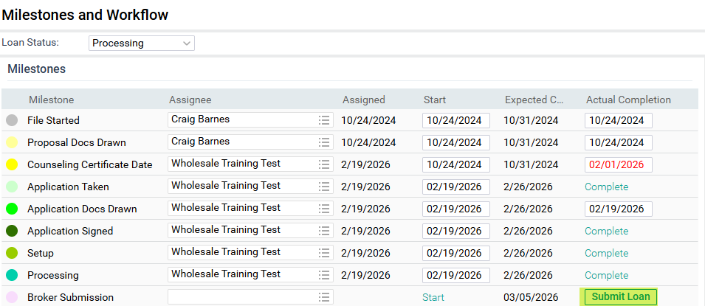
Loan Submission
Notes
Milestones and Loan Submission
Notes:
Tell us the story

Slide 179

Which is an allowable order of events?
FHA Case #, Counseling, Appraisal, Title, Credit
Counseling, Appraisal, FHA Case #, Title, Credit
Credit, Counseling, FHA Case #, Appraisal, Title
#3 – Credit (and preliminary title) maybe ordered early, everything else must be done after Case # Assignment
179

Slide 180
The Wholesale Loan Process
MUTUAL
Loan File
Intake
Underwriting
Closing
Funding
Insuring
File is submitted after all docs are signed, services received, LOEs written, and data input.
Reviews file and prepares file for Underwriting. Contacts partner if missing docs.
Reviews appraisal, title, income, credit, etc. Issues conditional approval.
Clears conditions
Closing is scheduled after UW issues Clear-to-Close. Partner completes Doc Order Form
Refinances fund after Rescission period is over.
Loan are insured by HUD (HECMs only) and generally placed in HMBS pools.
Notes:
Once all the required documents are ready and the Broker submits the loan, the file is sent to the File Intake Team. File Intake is responsible for reviewing each new loan file submission. The files are reviewed to ensure that all minimum submission requirements are met prior to submitting any loan into Underwriting for review.
If a file doesn’t meet the minimum submission requirements, an incomplete email notification is sent to the Broker contact provided on the submission checklist and the file is placed on hold until all outstanding items have been received.
File Intake is also checking the following details:
Liberty only accepts loan applications from properly approved Broker Partners
The Loan Officer must be properly licensed in the state where the subject property is located. Liberty will not accept or approve loans from an unlicensed mortgage loan originator.

Slide 181
Course Review
Part I
The Market and Myths
Part II
Calculations
Part III
Borrowers and Properties
Part IV
After Closing
Part V
Part VI
Loan Flow
Selling Reverse Mortgages

Slide 182

QUESTIONS?
182

Slide 183
Test
A 50-question test will be sent to all participants after the session’s conclusion.
A passing score of 75% is required to receive your certification.
Look for a link to the test in your email shortly.
After you complete and pass the test, a certificate will be mailed to you.
Good Luck!

Slide 184

These materials are designed to provide the reader with a general overview and understanding of the topic(s) presented and are not intended as a substitute for consultation with qualified legal counsel regarding the manner, in which the laws, regulations, and guidelines covered may apply to a particular fact pattern or business model. No part of this presentation may be reproduced, forwarded, copied, or redistributed in any form or by any means without the prior written consent of Mutual of Omaha Mortgage (“MOOM”). This presentation could include technical inaccuracies or typographical errors. MOOM does not guarantee the accuracy of the information provided and disclaims any and all express or implied warranties, including, but not limited to, any warranties of merchantability or fitness for a particular purpose or use. This presentation should not be construed as legal advice or relied on as a sole resource for any part of the Lifestyle Home Loan. Unauthorized reproduction, forwarding, distribution or display of this copyrighted work is subject to criminal and civil penalties under federal law. These materials are not from and were not approved by HUD or FHA.
184

Slide 185

Borrower must occupy home as primary residence and remain current on property taxes, homeowner’s insurance, the costs of home maintenance, and any HOA fees.
Mutual of Omaha Mortgage, Inc. dba Mutual of Omaha Reverse Mortgage, NMLS ID 1025894. 3131 Camino Del Rio N 1100, San Diego, CA 92108. Alabama Consumer Credit License 22123; Alaska Broker/Lender License AK1025894. Arizona Mortgage Banker License 0926603; Arkansas Combination Mortgage Banker/Broker/Servicer License 109250; Licensed by the Department of Financial Protection & Innovation under the California Residential Mortgage Lending Act, License 4131356; Colorado Mortgage Registration 1025894; Connecticut Mortgage Lender License ML-1025894; Delaware Lender License 028515; District of Columbia Mortgage Dual Authority License MLB1025894; Florida Mortgage Lender Servicer License MLD1827; Georgia Mortgage Lender License/Registration 46648; Hawaii Mortgage Loan Originator Company License HI-1025894; Idaho Mortgage Broker/Lender License MBL-2081025894; Illinois Residential Mortgage Licensee MB.6761115; Indiana-DFI Mortgage Lending License 43321; Iowa Mortgage Banker License 2019-0119; Kansas Mortgage Company License MC.0025612; Kentucky Mortgage Company License MC707287; Louisiana Residential Mortgage Lending License 1025894; Maine Supervised Lender License 1025894; Maryland Mortgage Lender License 21678; Massachusetts Mortgage Broker and Lender License MC1025894; Michigan 1st Mortgage Broker/Lender/Servicer Registrant FR0022702; Minnesota Residential Mortgage Originator Exemption MN-OX-1025894; Mississippi Mortgage Lender 1025894; Missouri Mortgage Company License 21-2472; Montana Mortgage Broker and Lender License 1025894; Nebraska Mortgage Banker License 1025894; Nevada Exempt Company Registration 4830. Licensed by the New Hampshire Banking Department, Mortgage Banker License 19926-MB; Licensed by the New Jersey Banking and Insurance Department. New Jersey Residential Mortgage Lender License 1025894; New Mexico Mortgage Loan Company License 1025894; North Carolina Mortgage Lender License L-186305; North Dakota Money Broker License MB103387; Ohio Residential Mortgage Lending Act Certificate of Registration RM.804535.000; Oklahoma Mortgage Lender License ML012498; Oregon Mortgage Lending License ML- 5208; Pennsylvania Mortgage Lender License 72932; Rhode Island Lender License 20163229LL. Rhode Island Loan Broker License 20163230LB; South Carolina BFI Mortgage Lender/Servicer License MLS-1025894; South Dakota Mortgage Lender License ML.05253; Tennessee Mortgage License 190182; Texas Mortgage Banker Registration 1025894; Utah Mortgage Entity License 8928021; Vermont Lender License 6891; Virginia Mortgage Broker and Lender License, NMLS ID #1025894 (www.nmlsconsumeraccess.org); Washington Consumer Loan Company License CL-1025894; Wisconsin Mortgage Banker License 1025894BA; Wyoming Mortgage Lender/Broker License 3488. (866) 200-3210. Subject to Credit Approval.
Charges such as an origination fee, mortgage insurance premiums, closing costs and/or servicing fees may be assessed and will be added to the loan balance. As long as you comply with the terms of the loan, you retain title until you sell or transfer the property, and, therefore, you are responsible for paying property taxes, insurance and maintenance. Failing to pay these amounts may cause the loan to become immediately due and/or subject the property to a tax lien, other encumbrance or foreclosure. The loan balance grows over time, and interest is added to that balance. Interest on a reverse mortgage is not deductible from your income tax until you repay all or part of the interest on the loan. Although the loan is non-recourse, at the maturity of the loan, the lender will have a claim against your property and you or your heirs may need to sell the property in order to repay the loan, or use other to repay the loan in order to retain the property.
These materials are not from HUD or FHA and the document was not approved by HUD, FHA or any Government Agency.
For licensing information, go to: www.nmlsconsumeraccess.org
185

Slide 186
Mutual of Omaha Mortgage, Inc. dba Mutual of Omaha Reverse Mortgage, NMLS ID 1025894. 3131 Camino Del Rio N 1100, San Diego, CA 92108. Subject to Credit Approval.
186

